Slide 1

Digital logic Design
8 Bit IC Calculator
Marwan Alfarra 202411140
Raneem Asha 202411476
Ahmad Sidawi 202410119

Slide 2
Objectives
Input any two numbers A and B from 0 to 15
Choose any operation between addition subtraction and multiplication
Convert 8 bits binary to decimal coded binary
Display A and B and the result of the operation between them

Slide 3
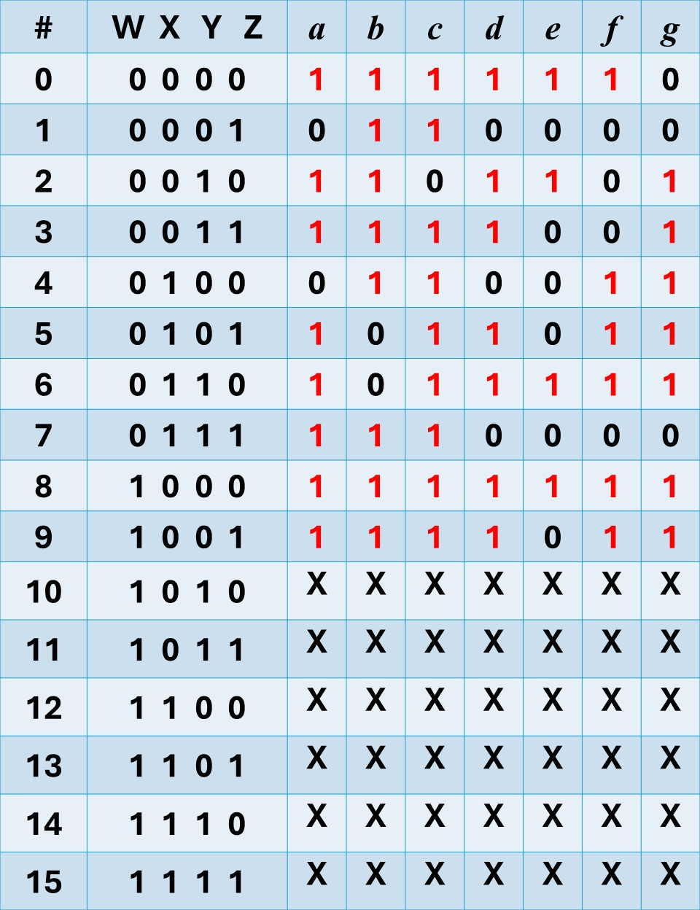
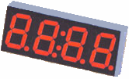
Seven-Segment Driver
a
f
g
b
w
x
y
z
a
b
c
d
e
f
g
?
e
c
BCD code
d
 |  |  |  | y
 |  | 1 |  | 1 | 1
 |  |  | 1 | 1 | 1 | x
w |  | x | x | x | x
 |  | 1 | 1 | x | x
 |  |  | z
a = w + y + xz + x’z’

Slide 4
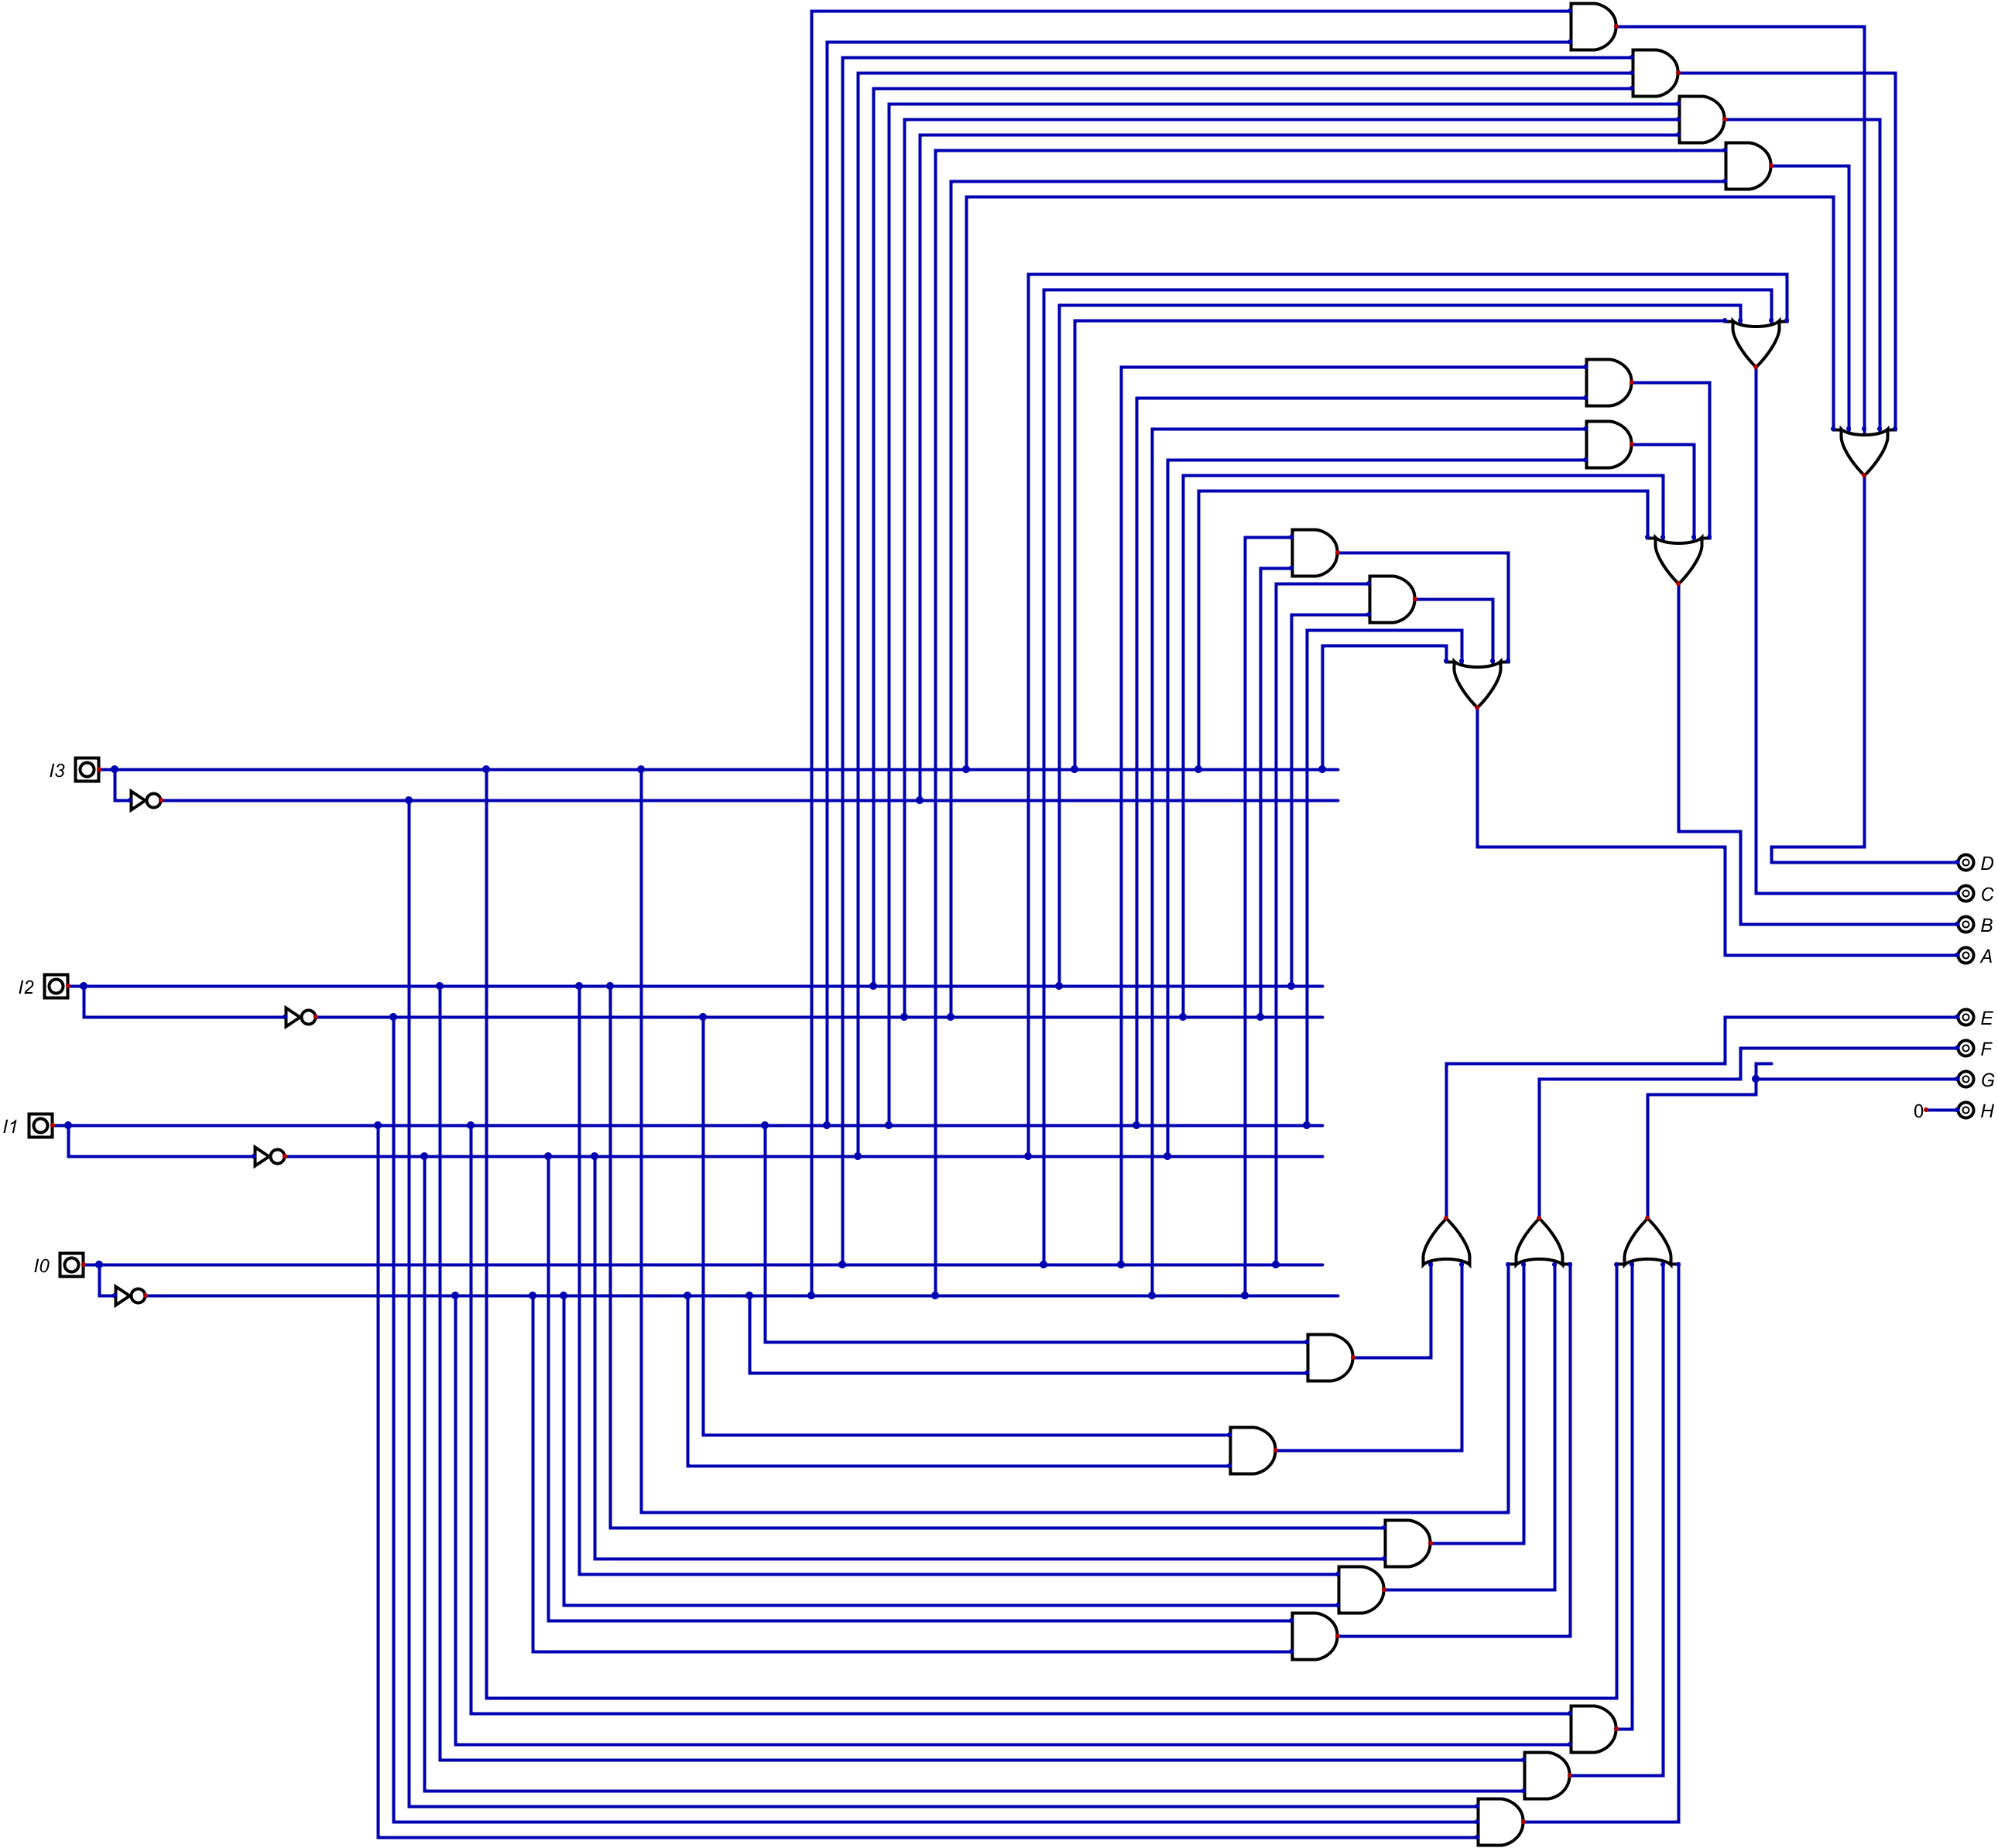
7-Segment driver

Slide 5
4B Double Dabble
BCD Tens | BCD Ones | Binary
8 | 4 | 2 | 1 | 8 | 4 | 2 | 1
 |  |  |  |  |  |  |  | A | B | C | D
 |  |  |  |  |  |  | A | B | C | D
 |  |  |  |  |  | A | B | C | D
 |  |  |  |  | A | B | C | D
 |  |  |  | Z3 | Z2 | Z1 | Z0 | D
 |  |  | Z3 | Z2 | Z1 | Z0 | D
T3 | T2 | T1 | T0 | O3 | O2 | O1 | O0

Slide 6
8B Double Dabble
BCD Hundreds | BCD Tens | BCD Ones | Binary
8 | 4 | 2 | 1 | 8 | 4 | 2 | 1 | 8 | 4 | 2 | 1 | --- | --- | --- | --- | --- | --- | --- | ---
 |  |  |  |  |  |  |  |  |  |  |  | A | B | C | D | E | F | G | H
 |  |  |  |  |  |  |  |  |  |  | A | B | C | D | E | F | G | H
 |  |  |  |  |  |  |  |  |  | A | B | C | D | E | F | G | H
 |  |  |  |  |  |  |  | 0 | A | B | C | D | E | F | G | H
 |  |  |  |  |  |  |  | T3 | T2 | T1 | T0 | D | E | F | G | H
 |  |  |  |  |  |  | T3 | T2 | T1 | T0 | D | E | F | G | H
 |  |  |  |  |  |  | T3 | U3 | U2 | U1 | U0 | E | F | G | H
 |  |  |  |  |  | T3 | U3 | U2 | U1 | U0 | E | F | G | H
 |  |  |  |  |  | T3 | U3 | V3 | V2 | V1 | V0 | F | G | H
 |  |  |  | 0 | T3 | U3 | V3 | V2 | V1 | V0 | F | G | H
 |  |  |  | W3 | W2 | W1 | W0 | X3 | X2 | X1 | X0 | G | H
 |  |  | W3 | W2 | W1 | W0 | X3 | X2 | X1 | X0 | G | H
 |  |  | W3 | Y3 | Y2 | Y1 | Y0 | Z3 | Z2 | Z1 | Z0 | H
 |  | W3 | Y3 | Y2 | Y1 | Y0 | Z3 | Z2 | Z1 | Z0 | H
H3 | H2 | H1 | H0 | T3 | T2 | T1 | T0 | O3 | O2 | O1 | O0

Slide 7
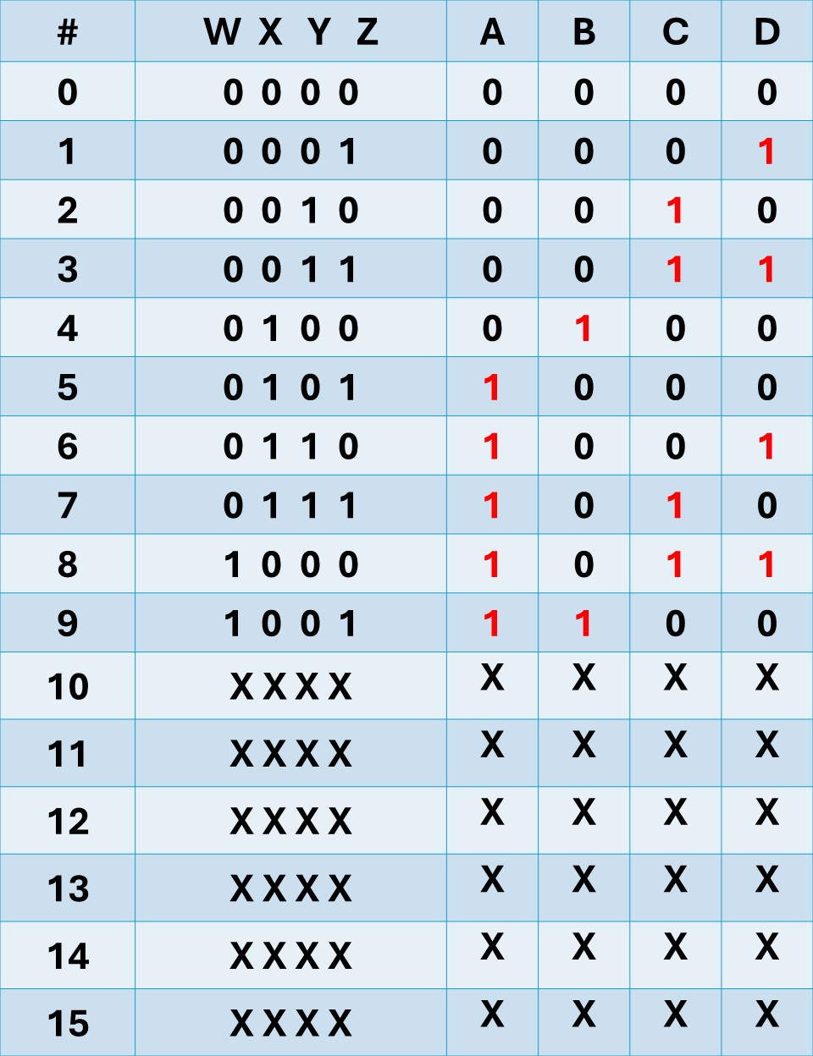
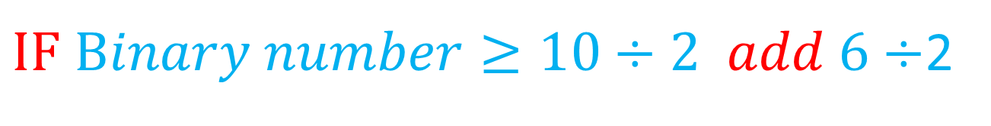

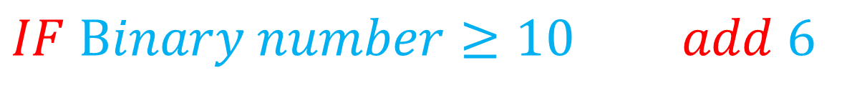
Double Dabble
Shift binary number 1 space to the left
IF the binary number can be greater than or equal to 5 we add 3
$$IF Binary number≥10 add 6$$
$IF Binary number≥10÷2 add 6÷$2
IF $Binary number≥5 add 3$

Slide 8
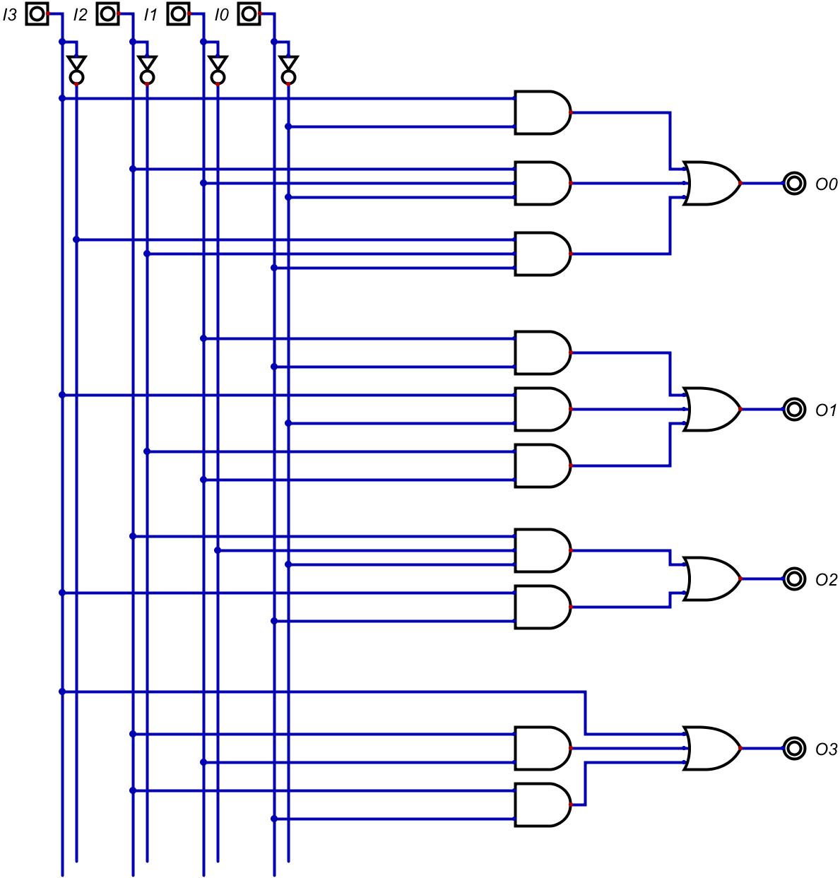
Double Dabble

Slide 9
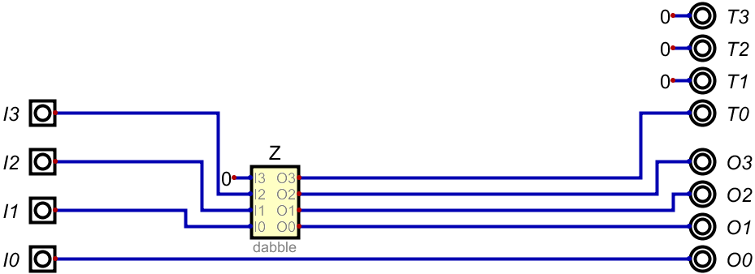
4B Double Dabble (DDA 45B)

Slide 10
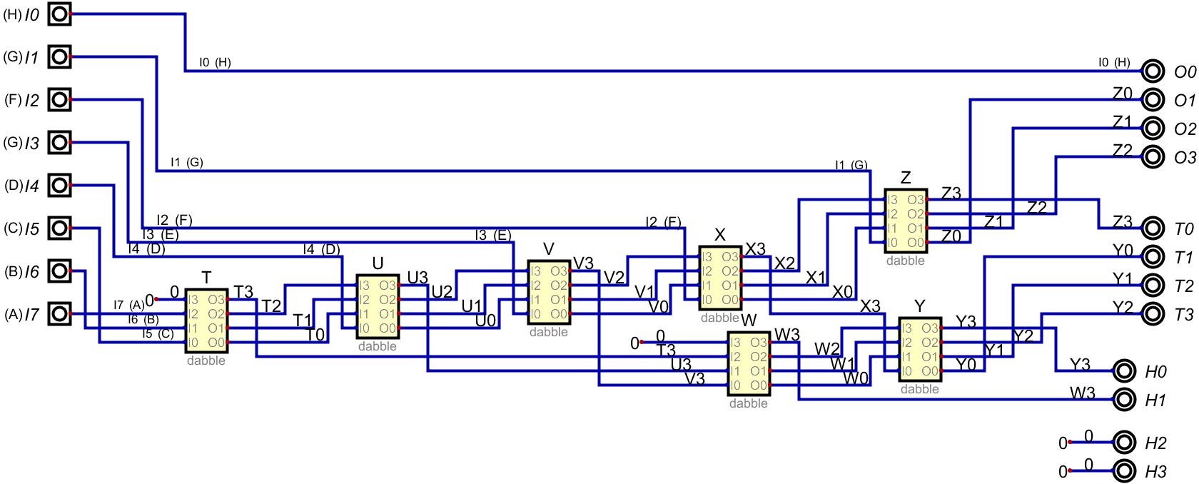
8B Double Dabble (DDA 8B)

Slide 11
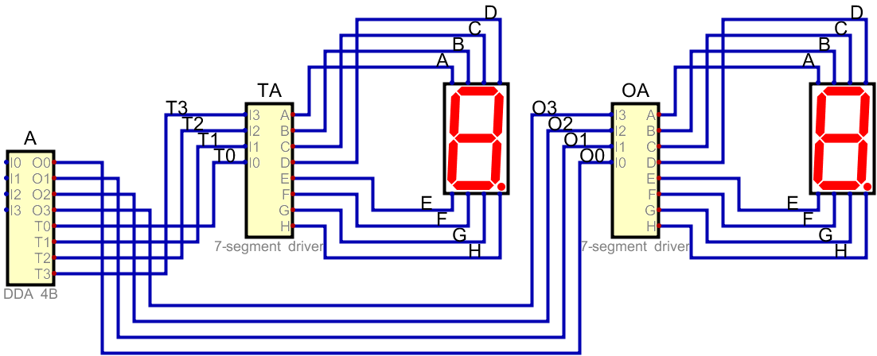
Output 1

Slide 12

Output 2

Slide 13
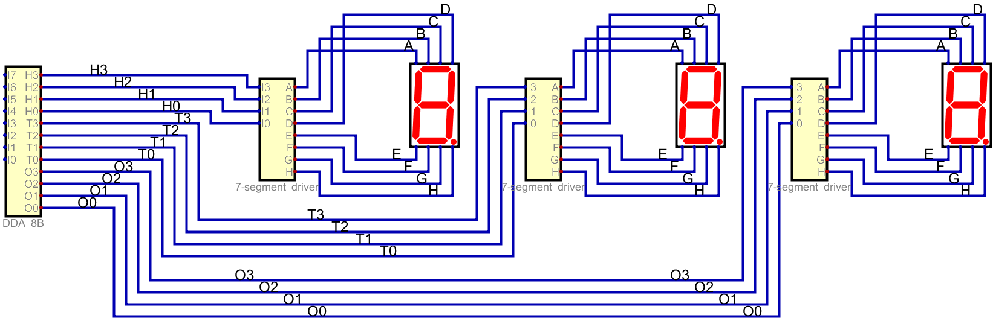
Output 5

Slide 14
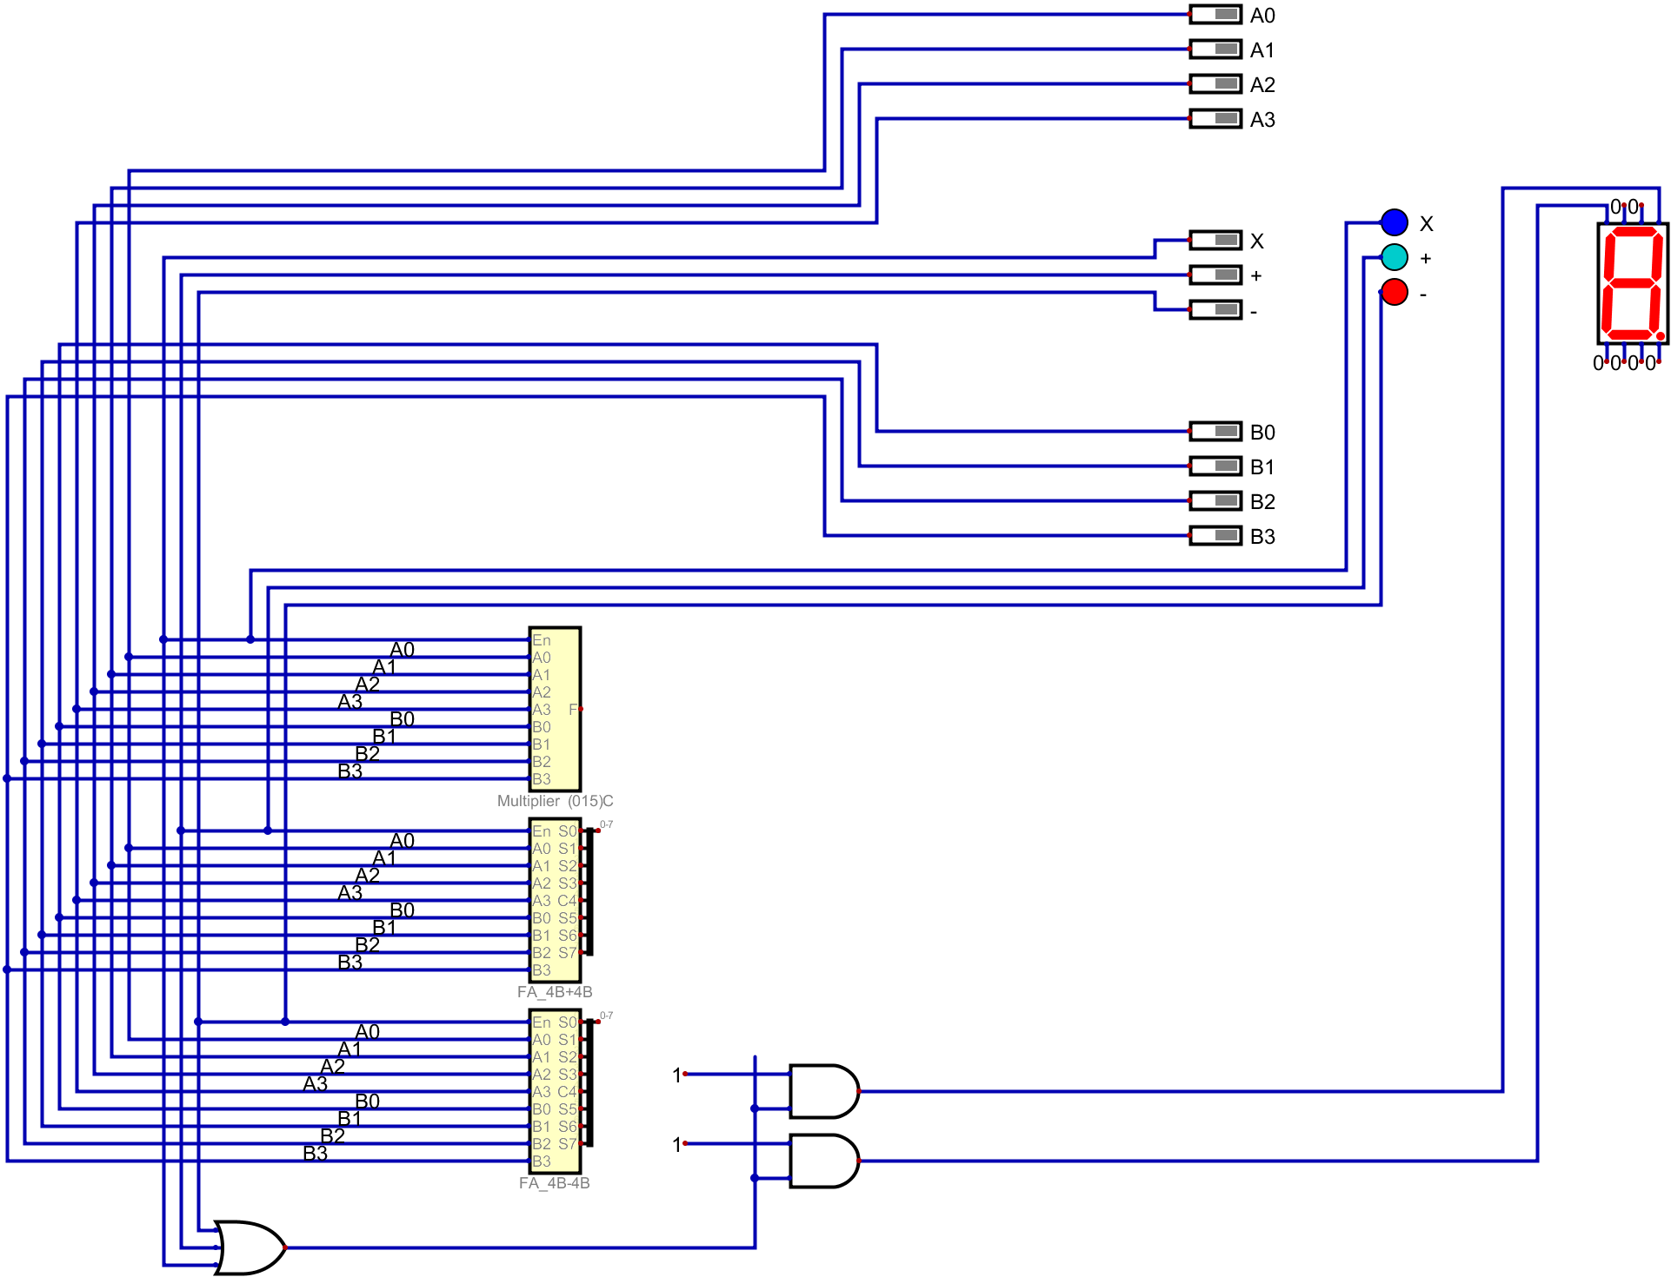
Input 1 (A)
Output 4
Output 3
Input 2 (OP)
Input 3 (B)

Slide 15
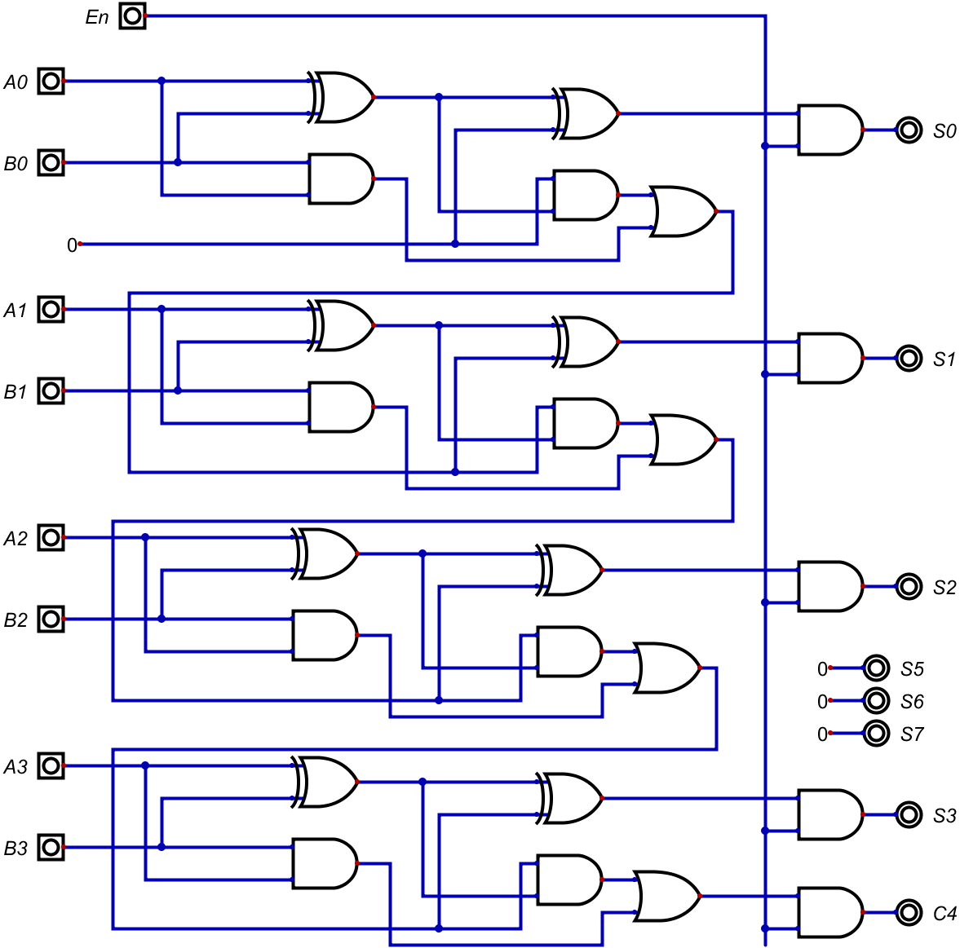
Operation Addition
(FA_4B+4B)

Slide 16
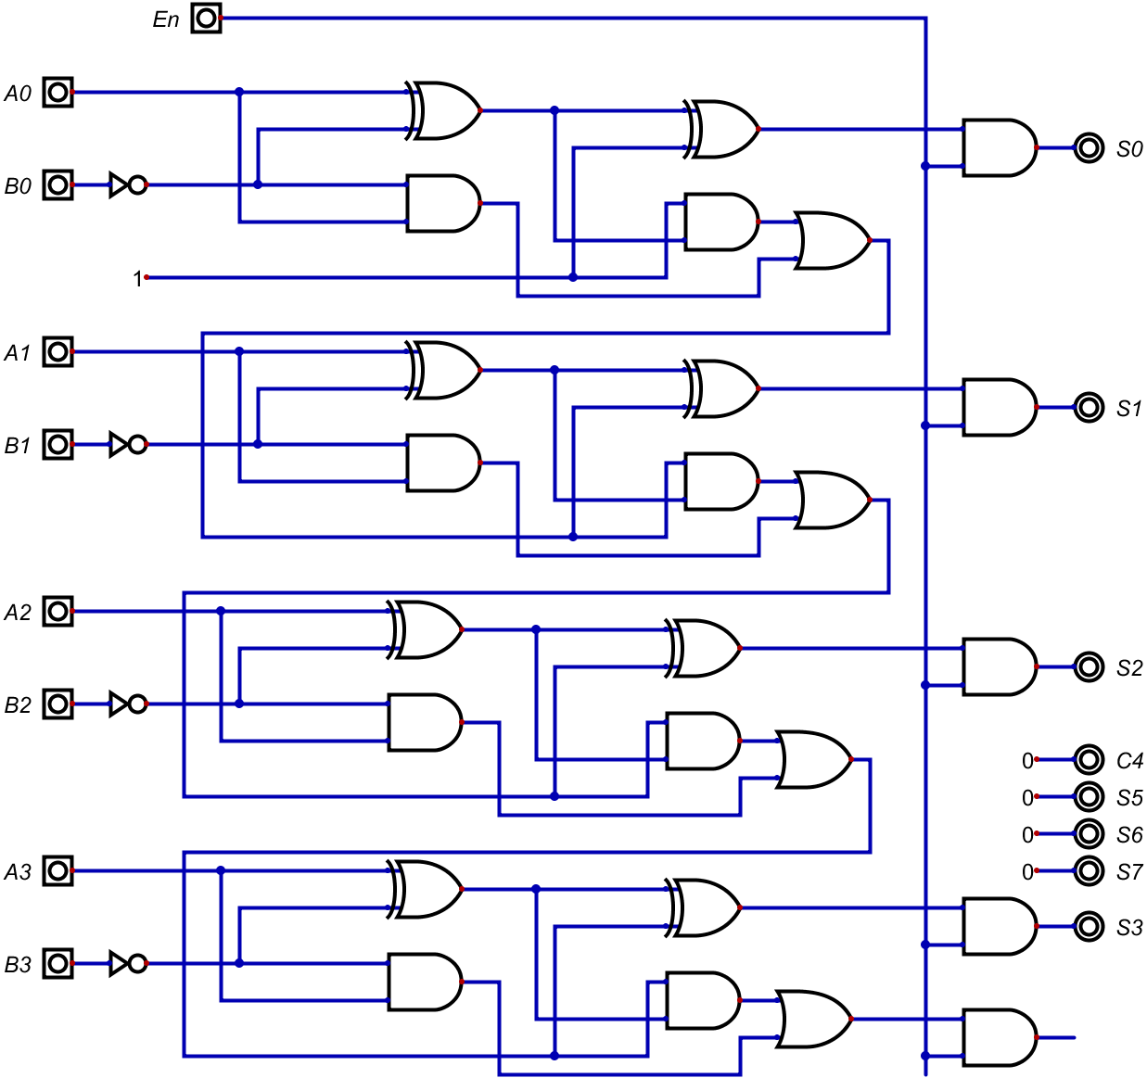
Operation Subtraction
(FA_4B-4B)

Slide 17
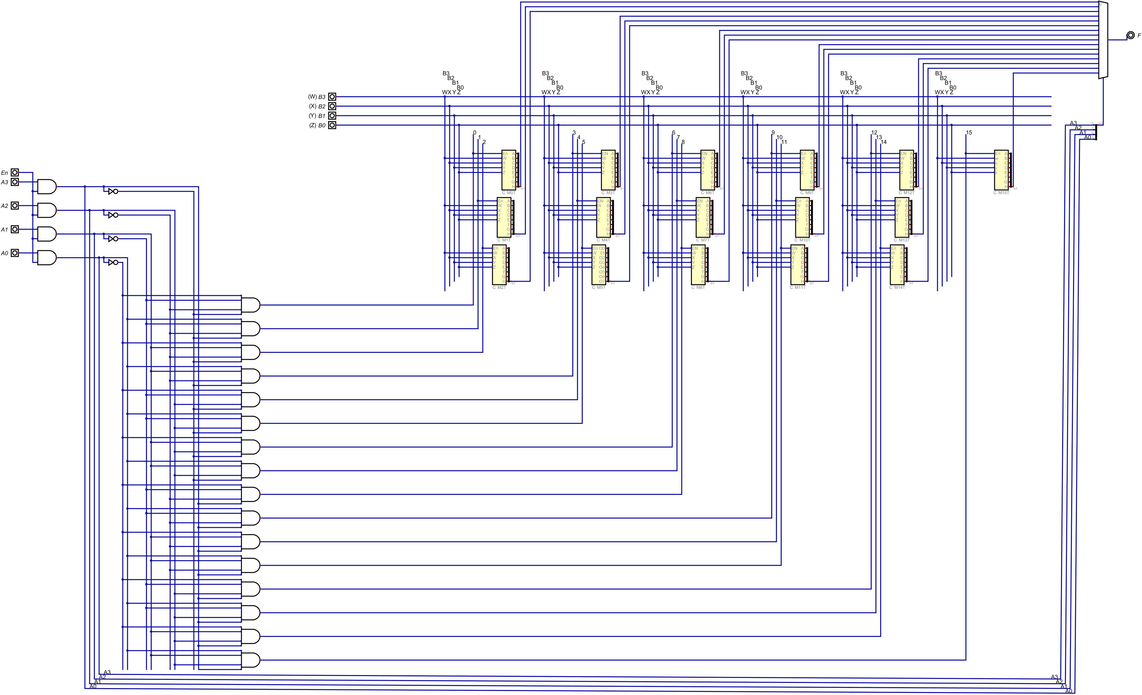
Operation Multiplication (015)C

Slide 18
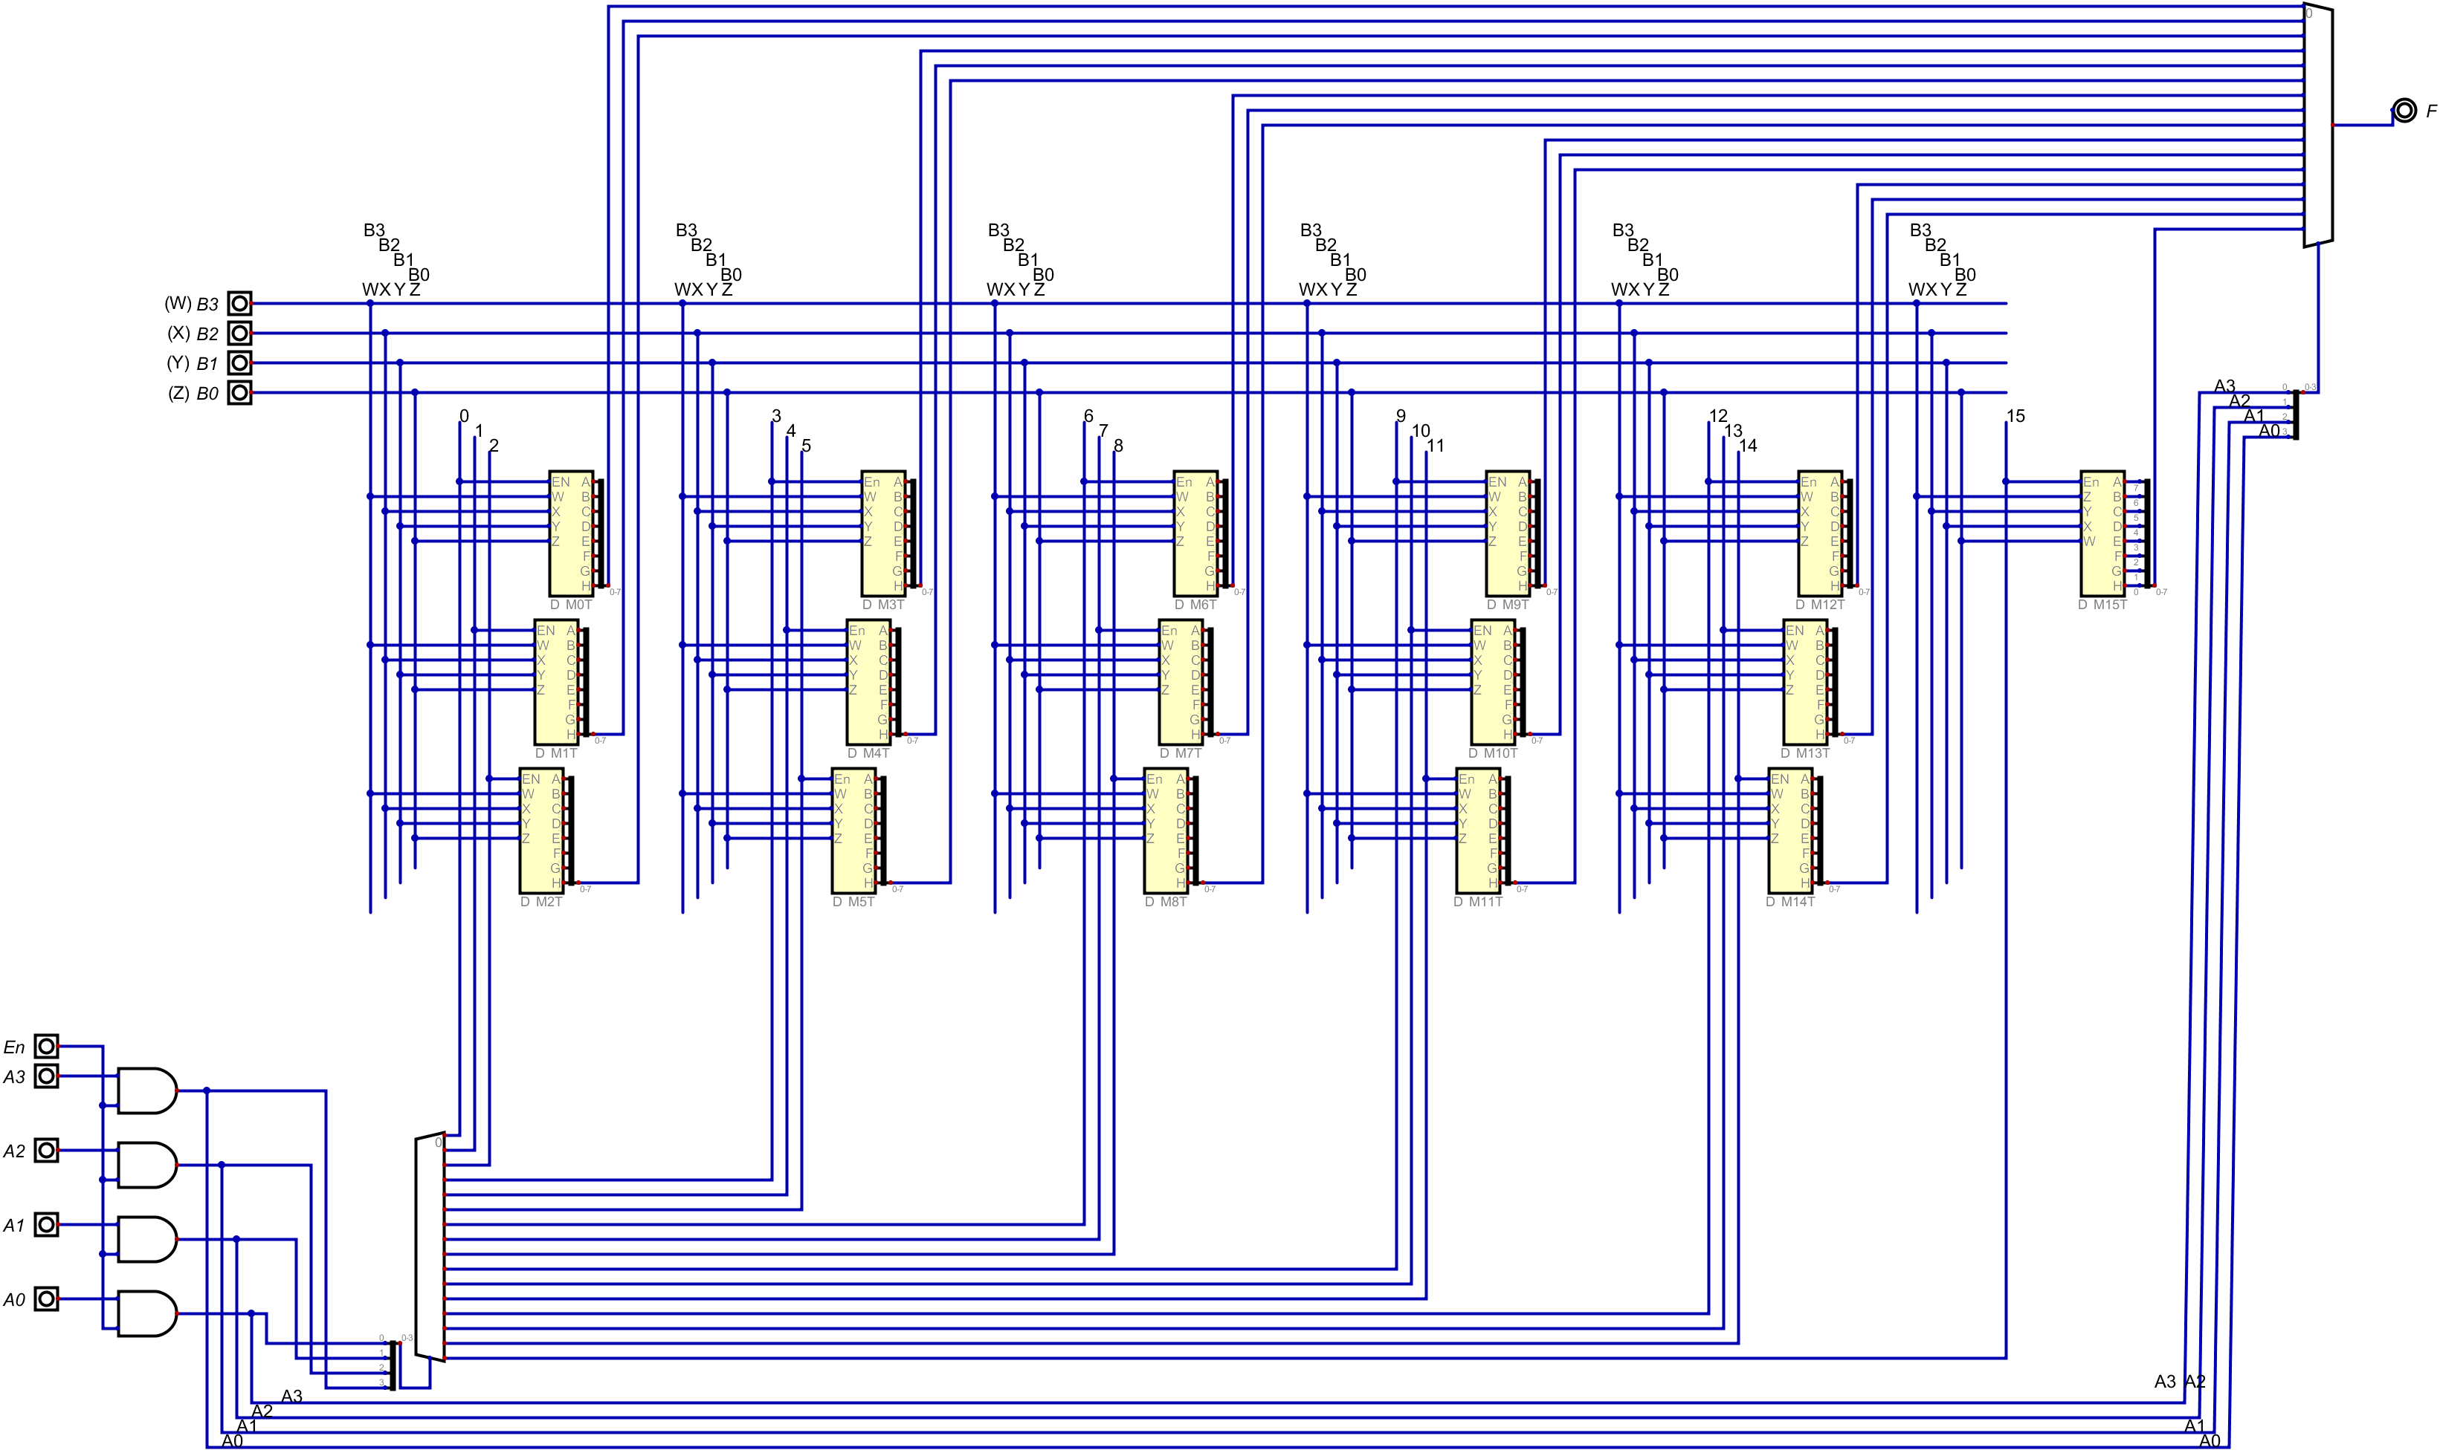
Operation Multiplication (015)D

Slide 19
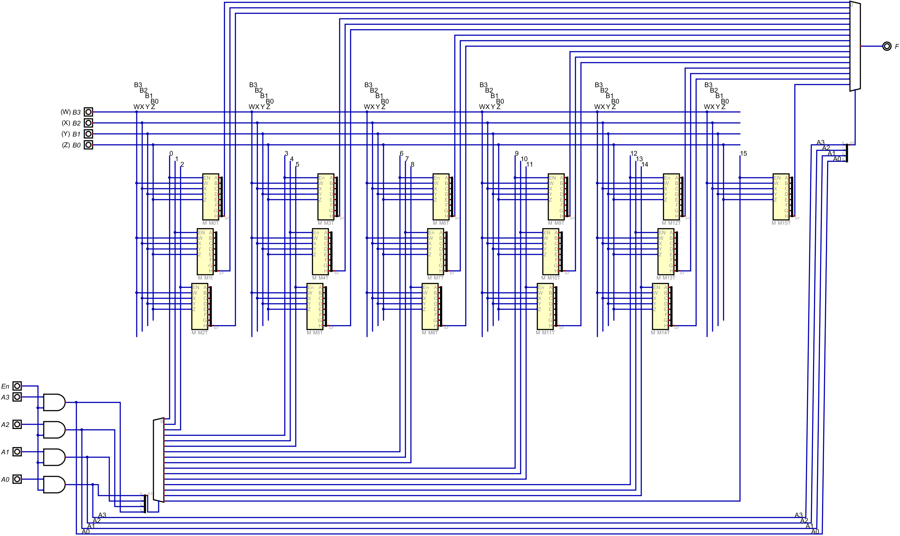
Operation Multiplication (015)M

Slide 20
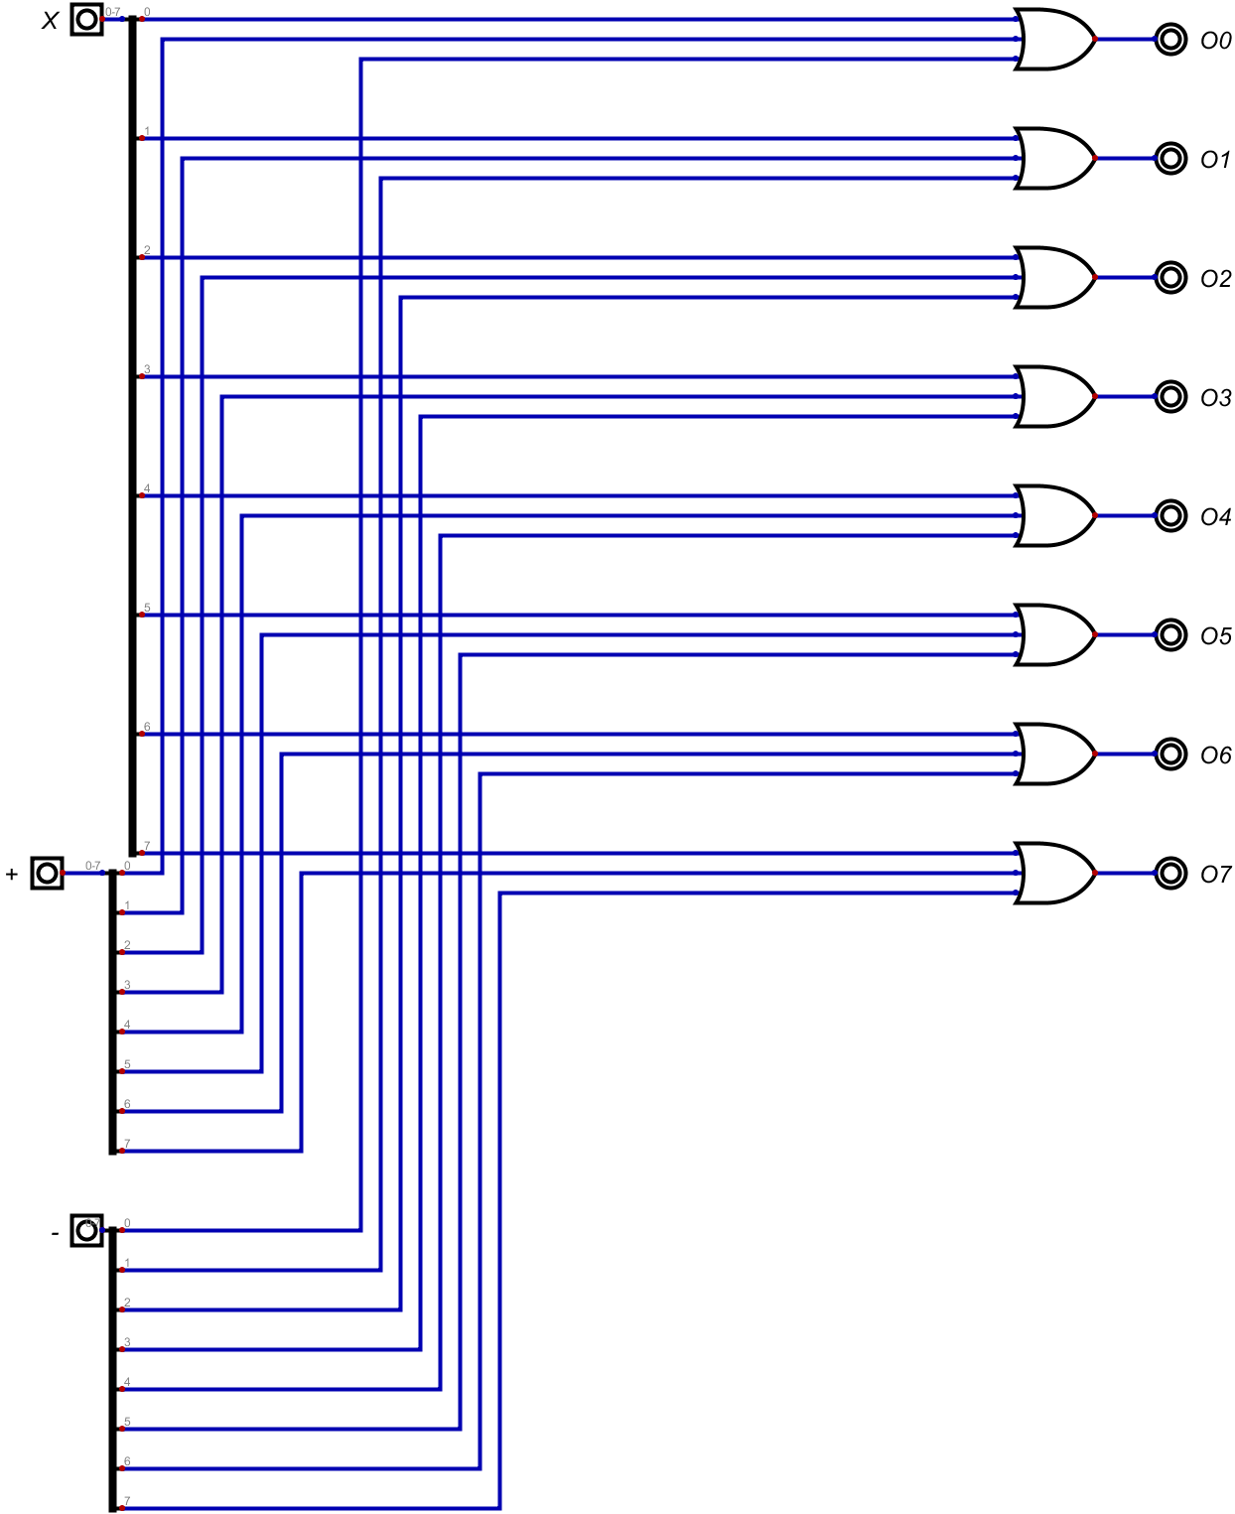
Operation Selector (OS)

Slide 21
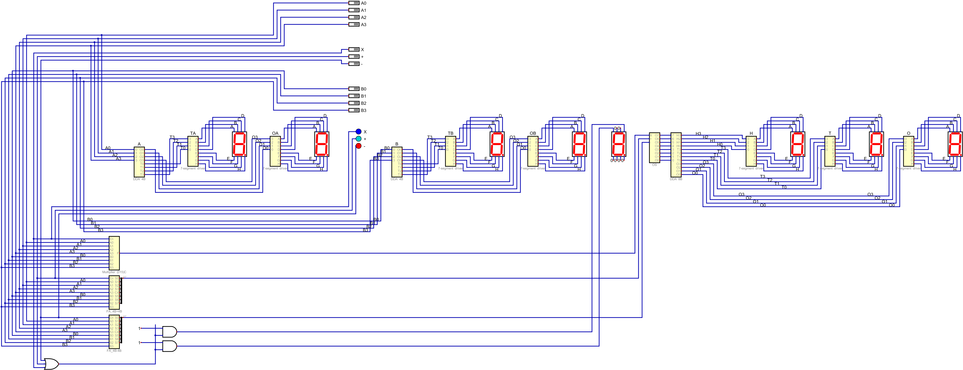

Slide 22
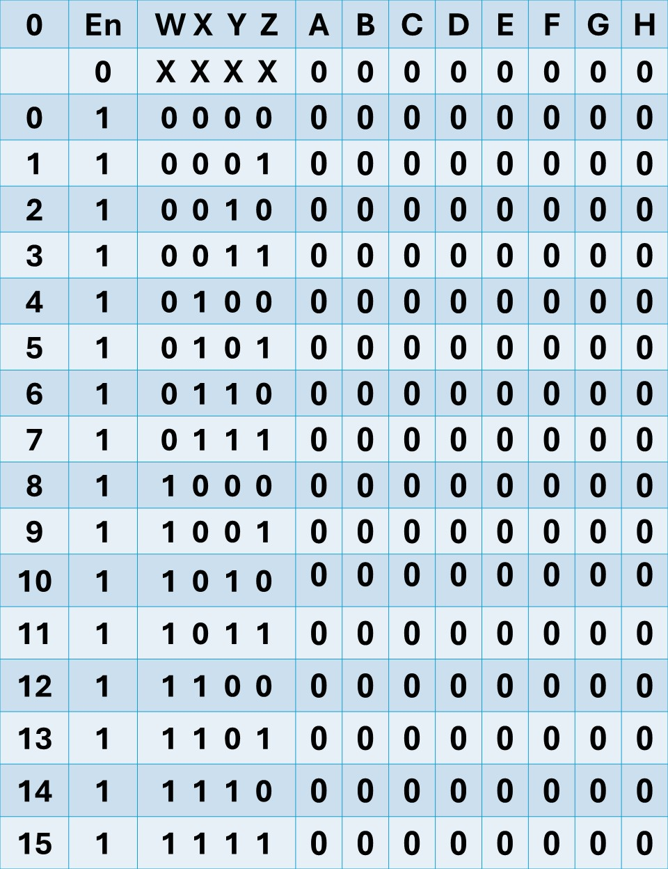
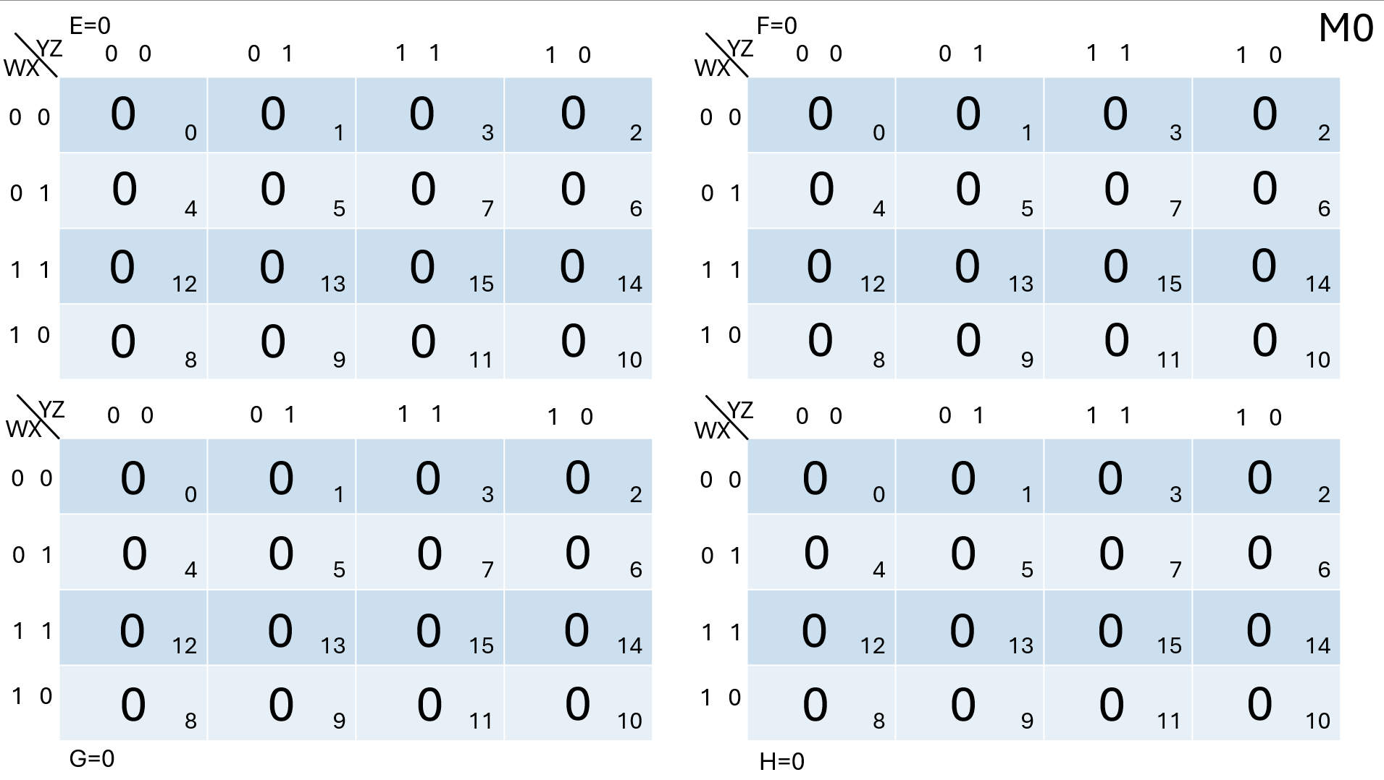
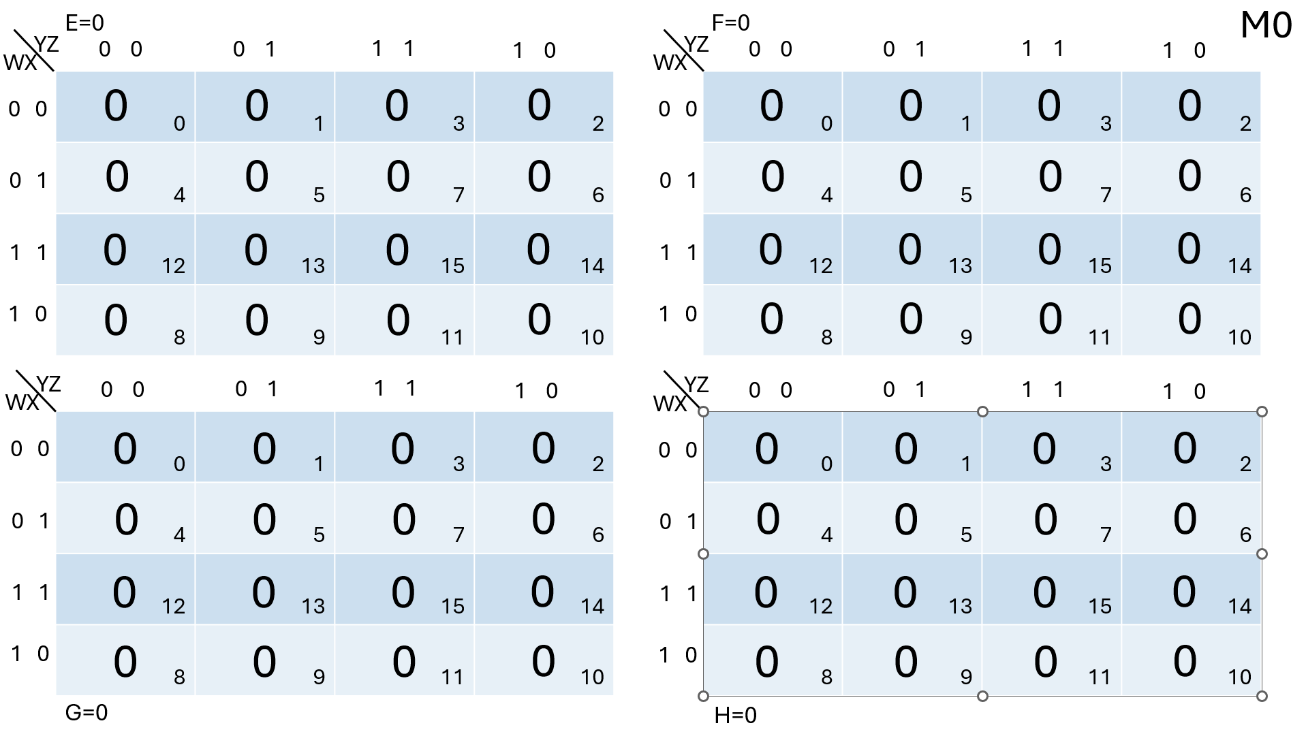
Multiplication table of Zero

Slide 23
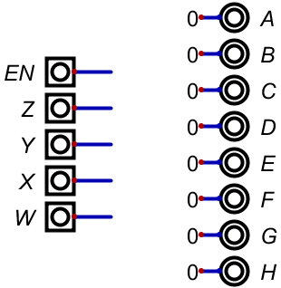
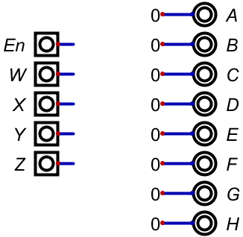
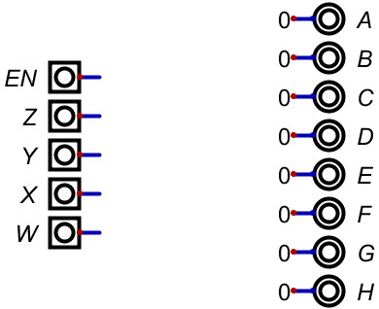
Multiplication table of Zero design
Combinational (C M0T)
Decoder (D M0T)
Multiplexer (M M0T)

Slide 24
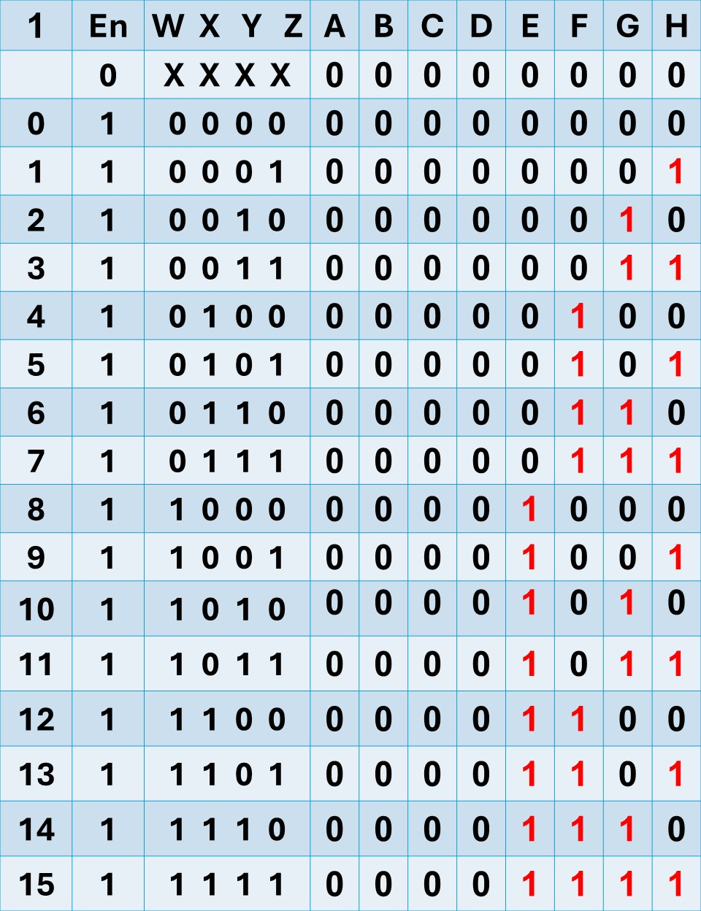
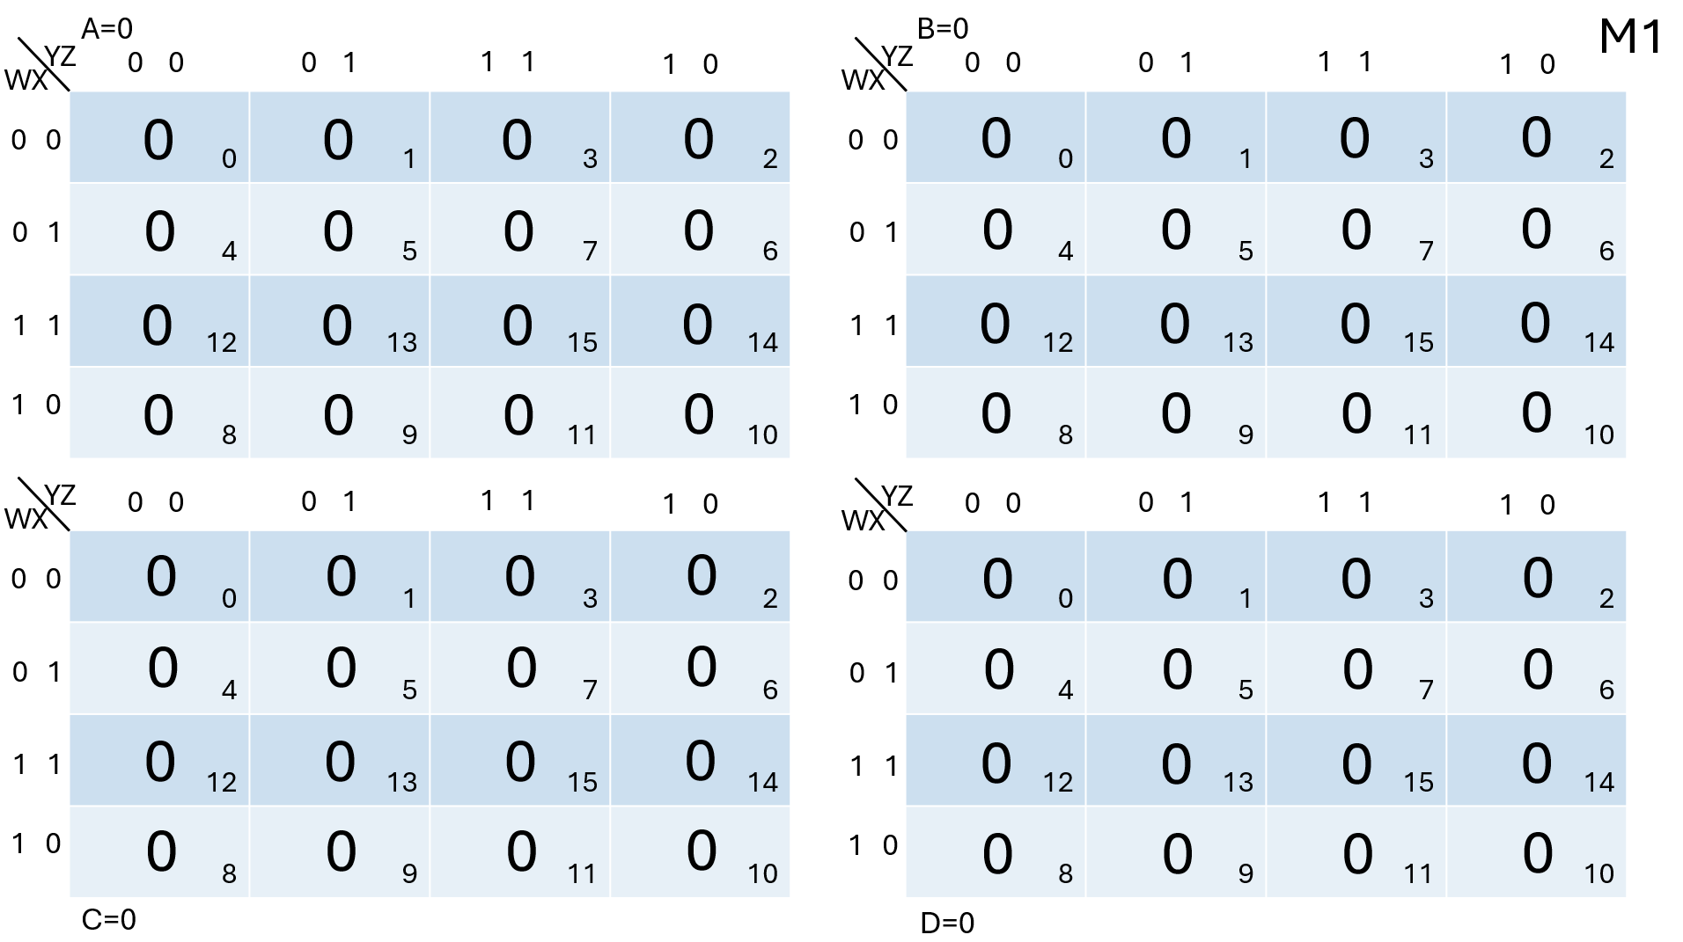
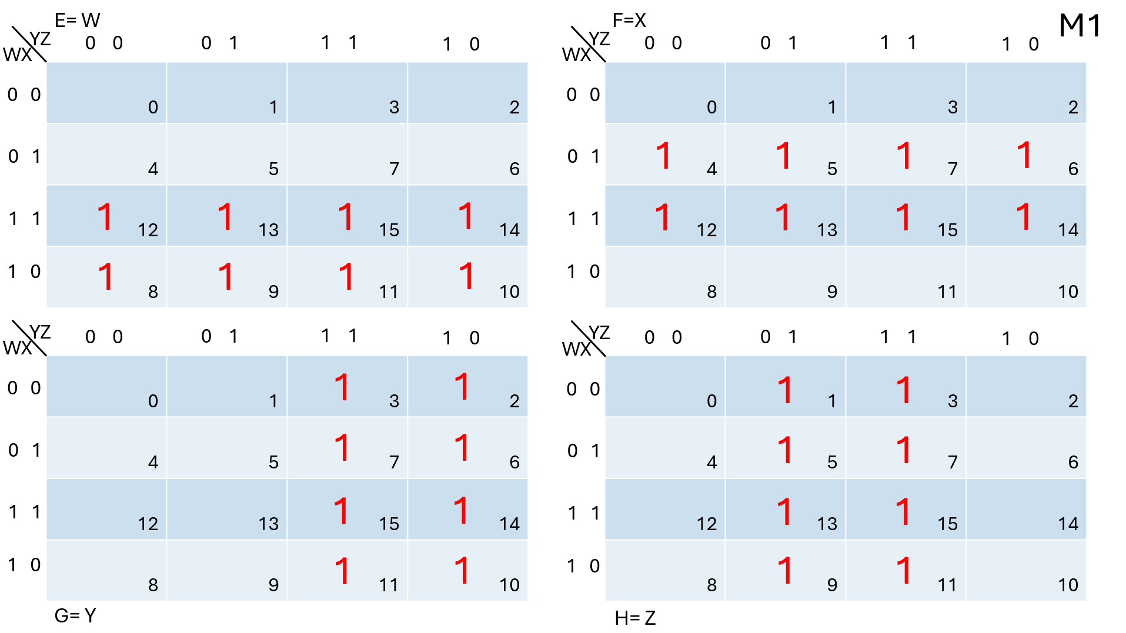
Multiplication table of One

Slide 25
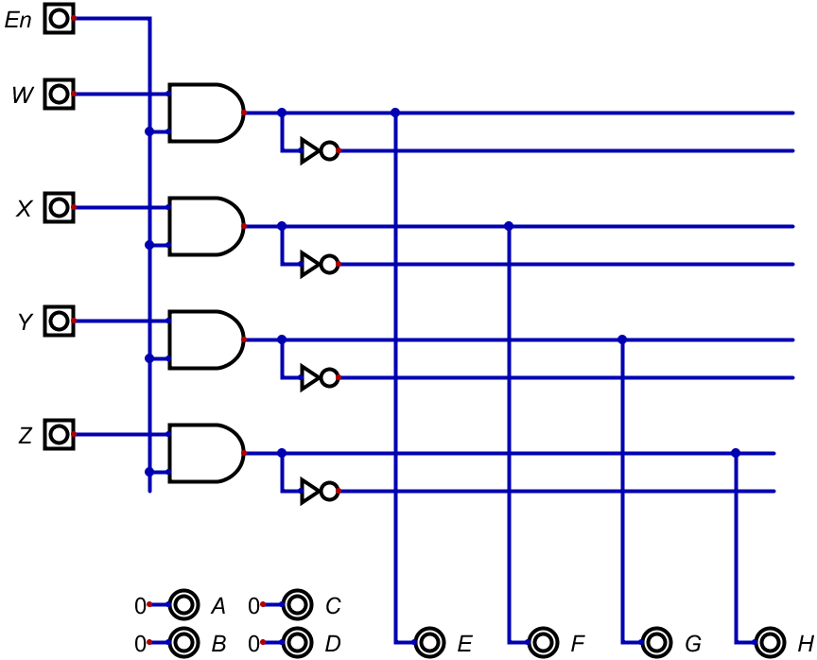
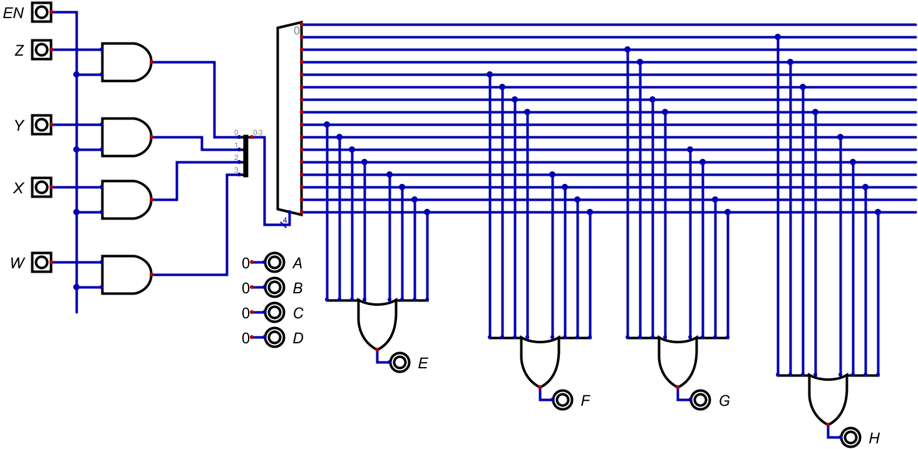
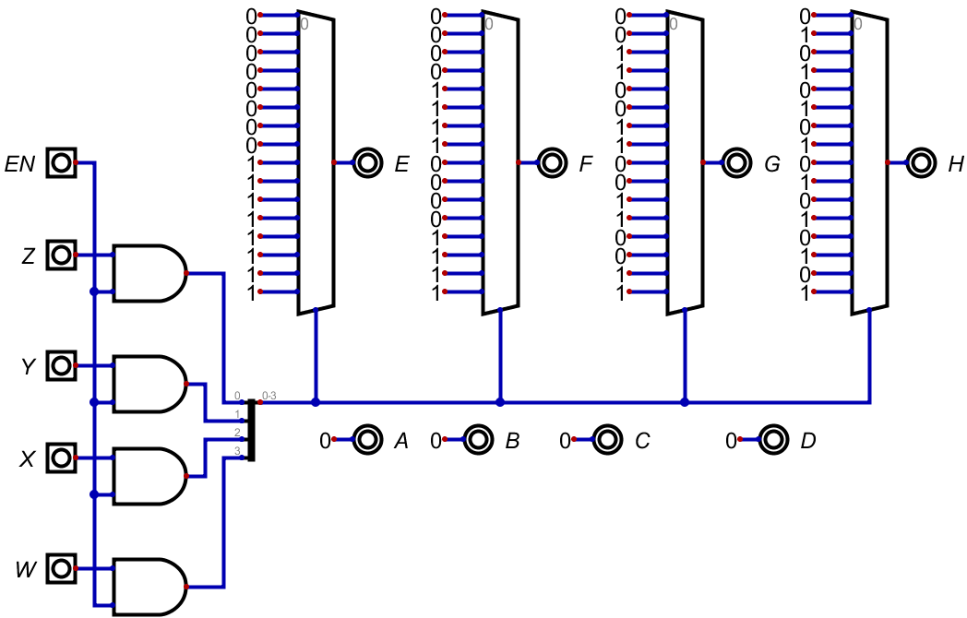
Multiplication table of One design
Combinational (C M1T)
Decoder (D M1T)
Multiplexer (M M1T)

Slide 26
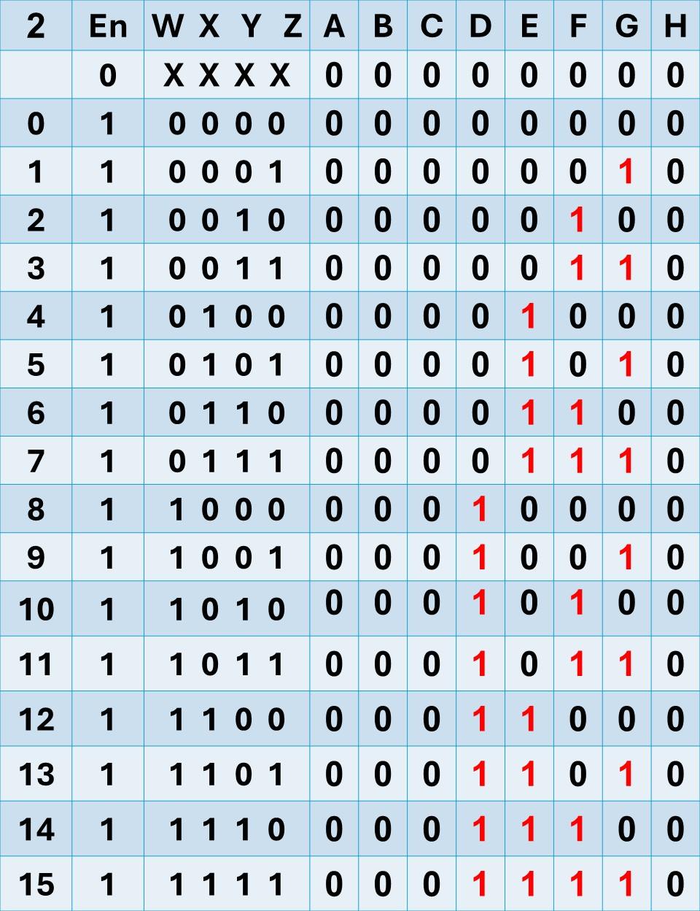
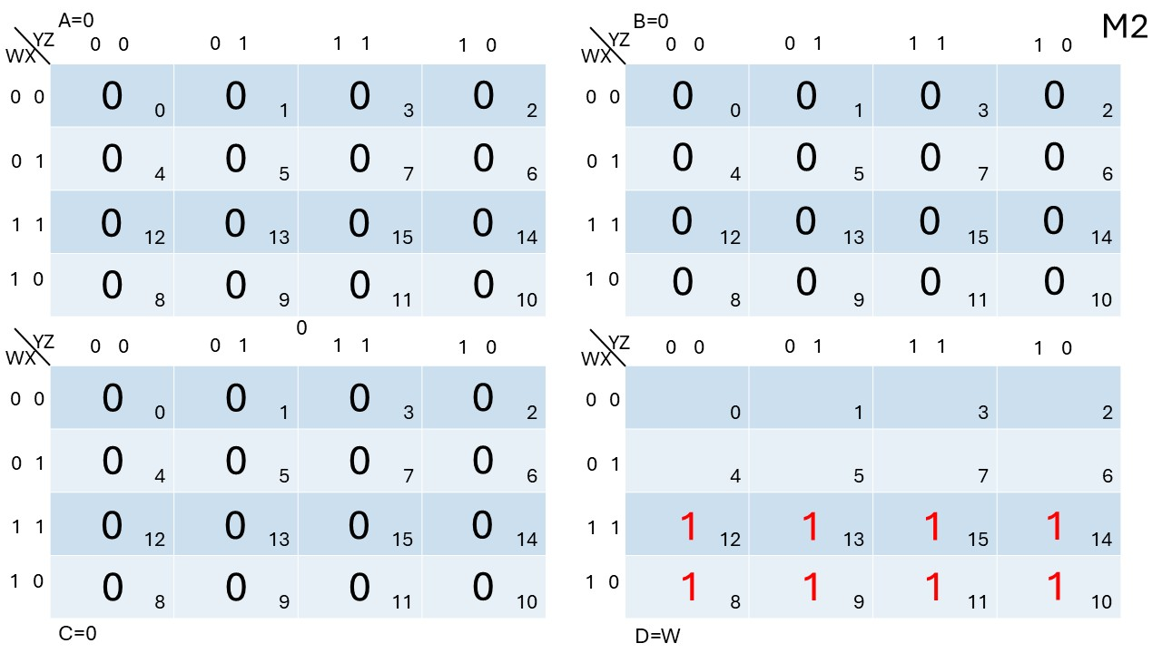
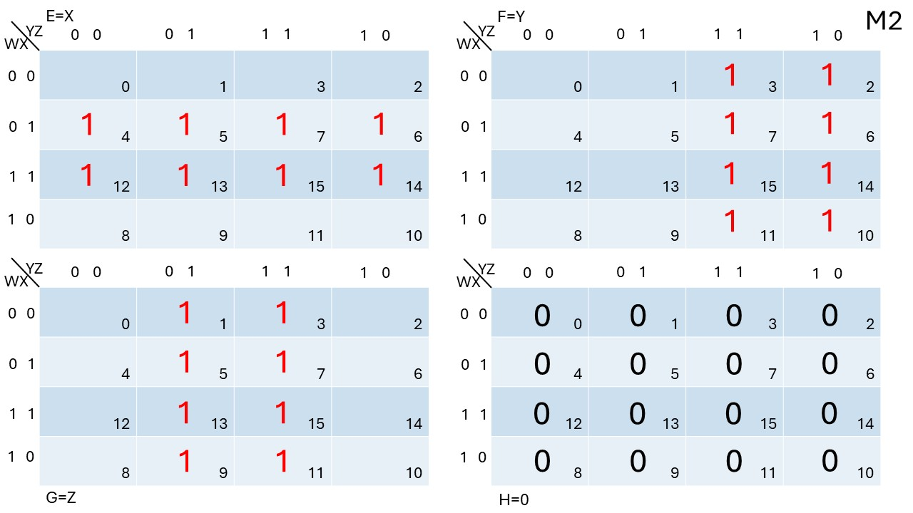
Multiplication table of Two

Slide 27
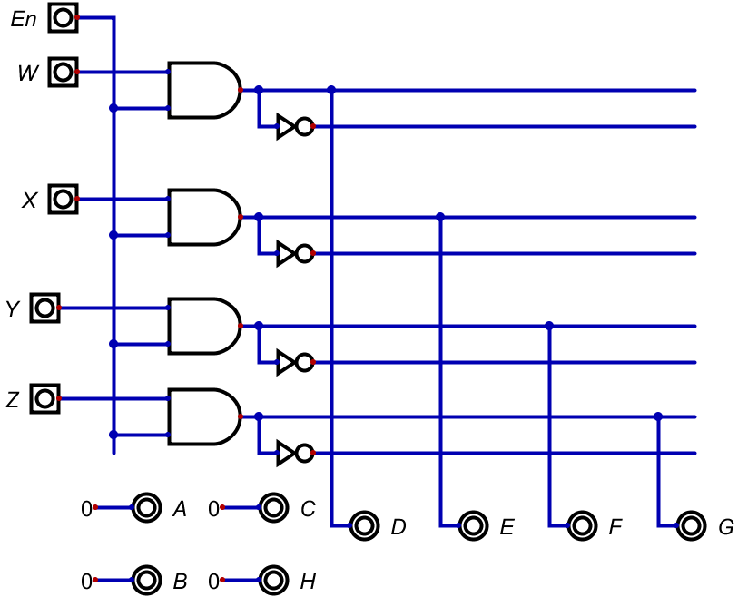
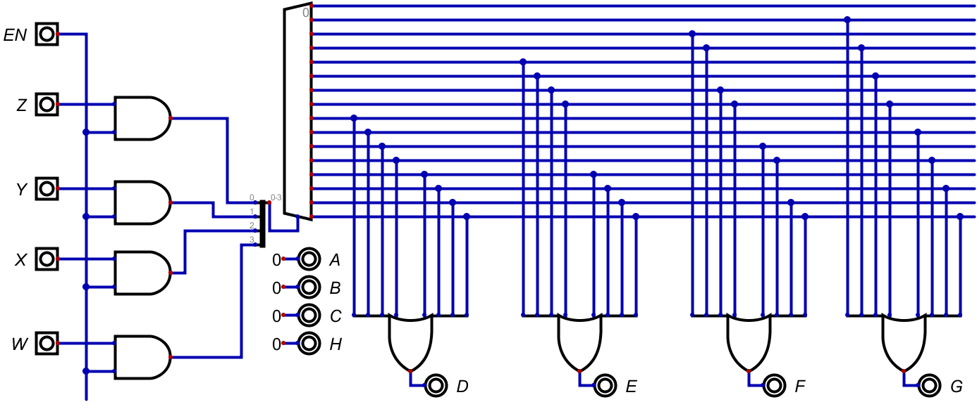
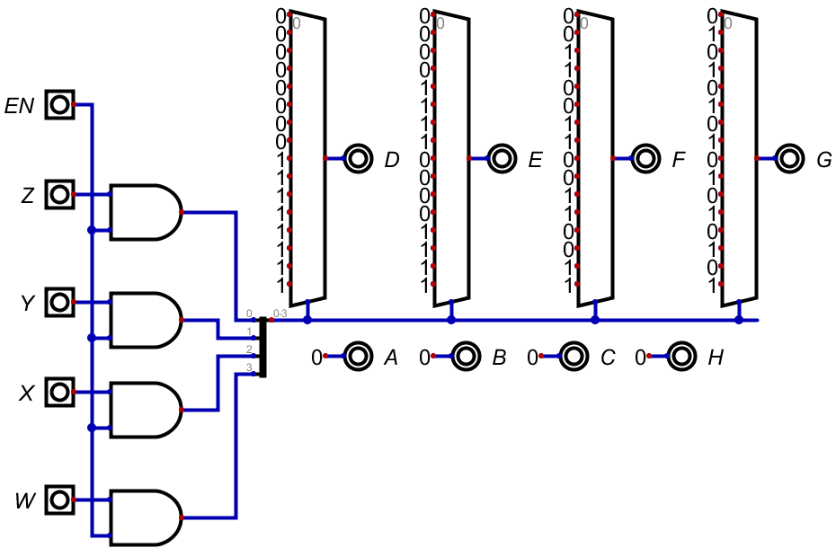
Multiplication table of Two design
Combinational (C M2T)
Decoder (D M2T)
Multiplexer (M M2T)

Slide 28
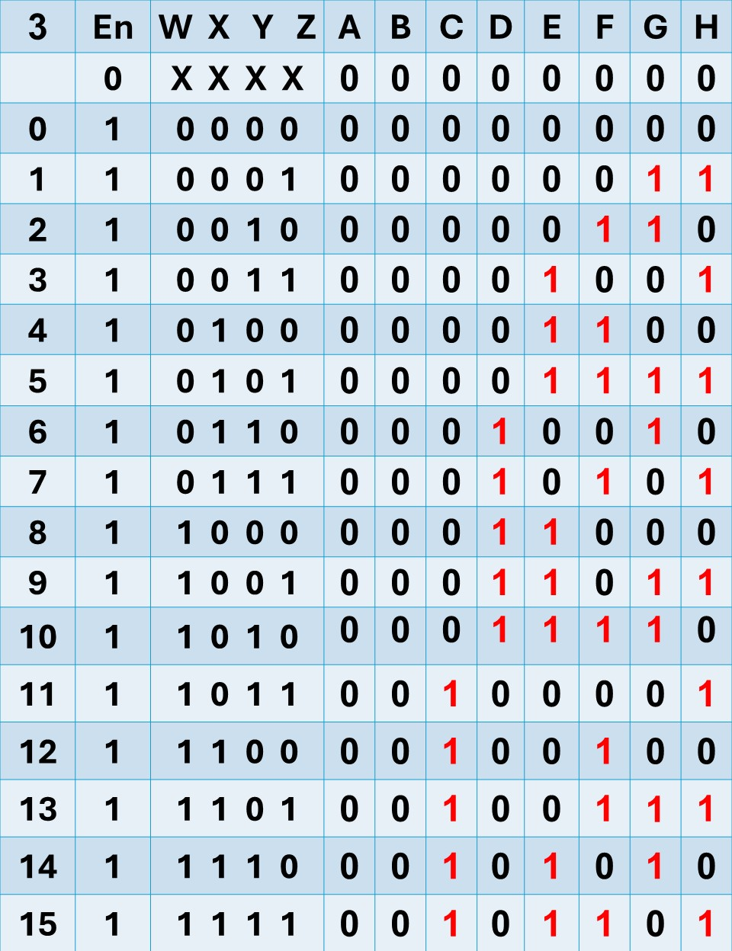
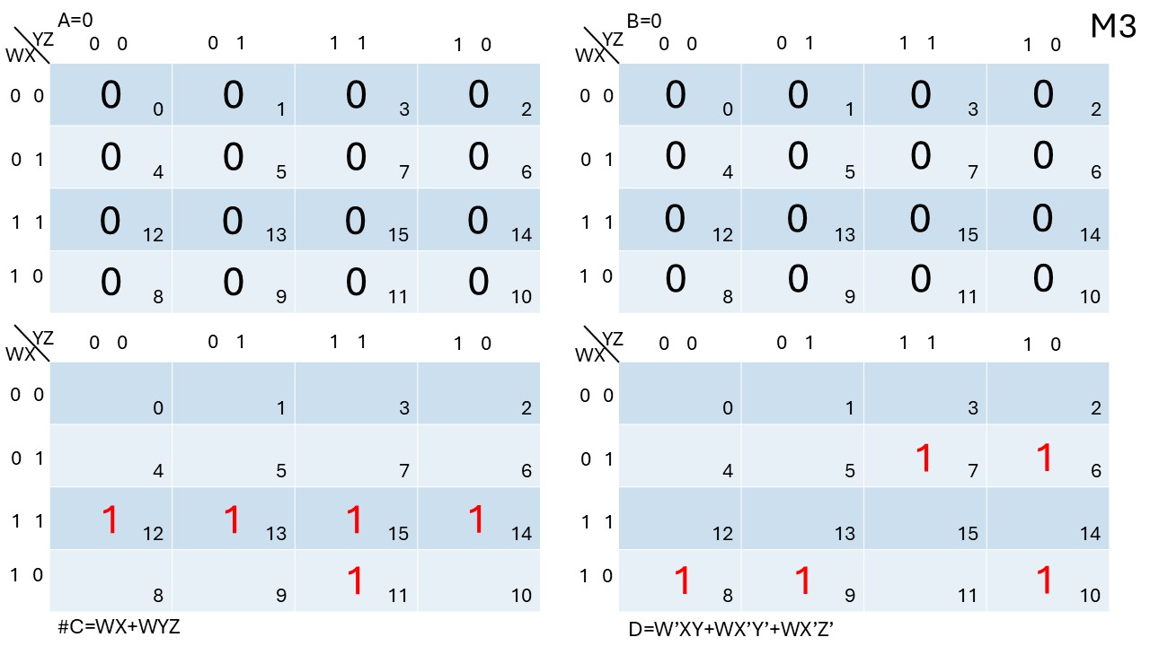
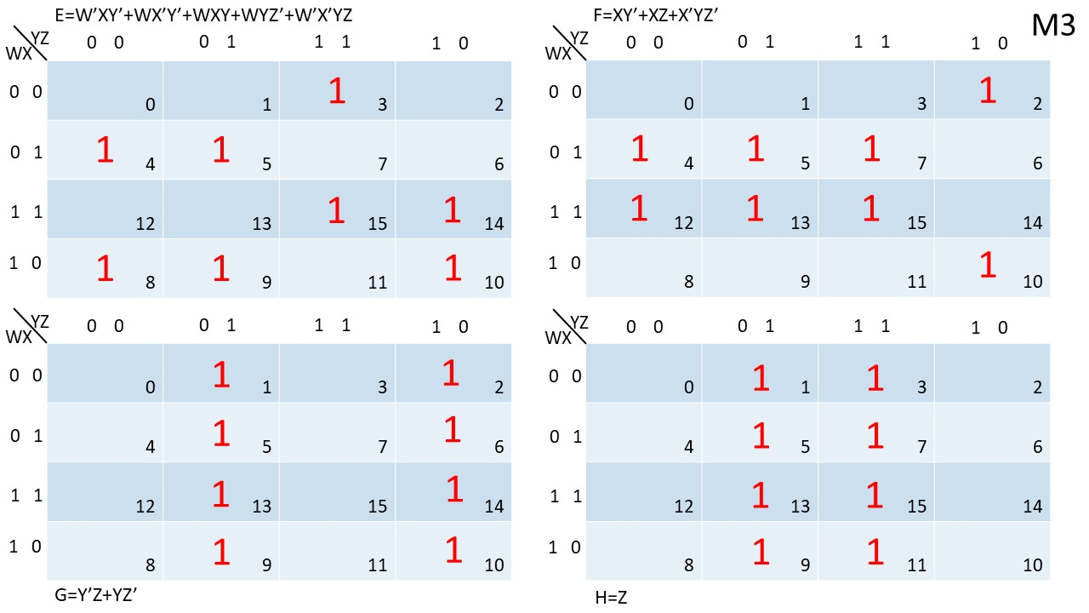
Multiplication table of Three

Slide 29
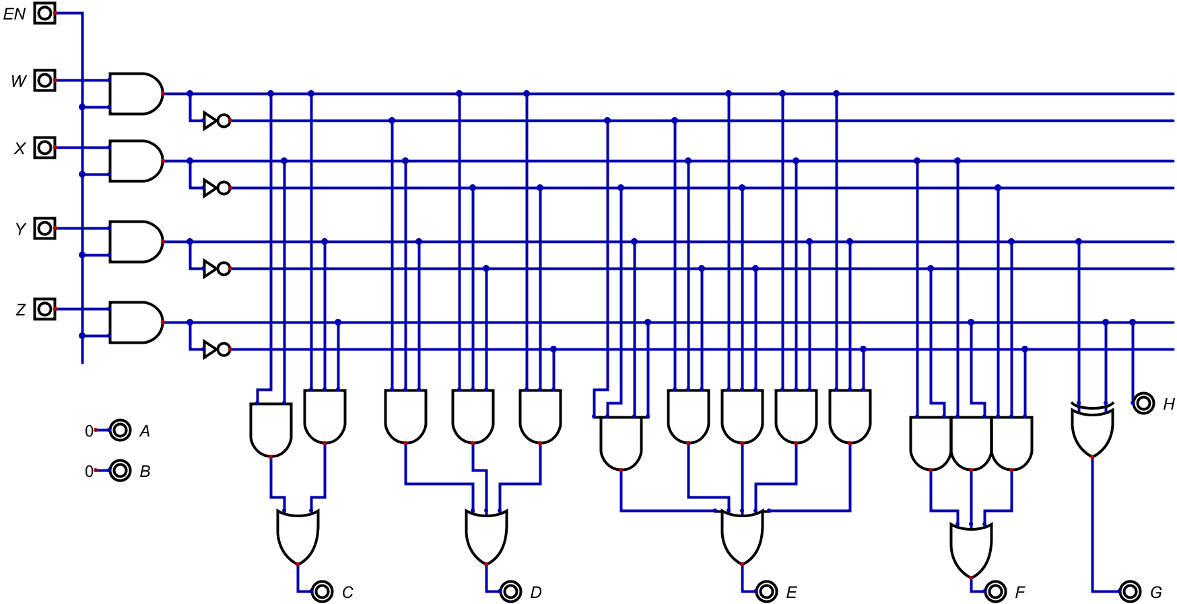
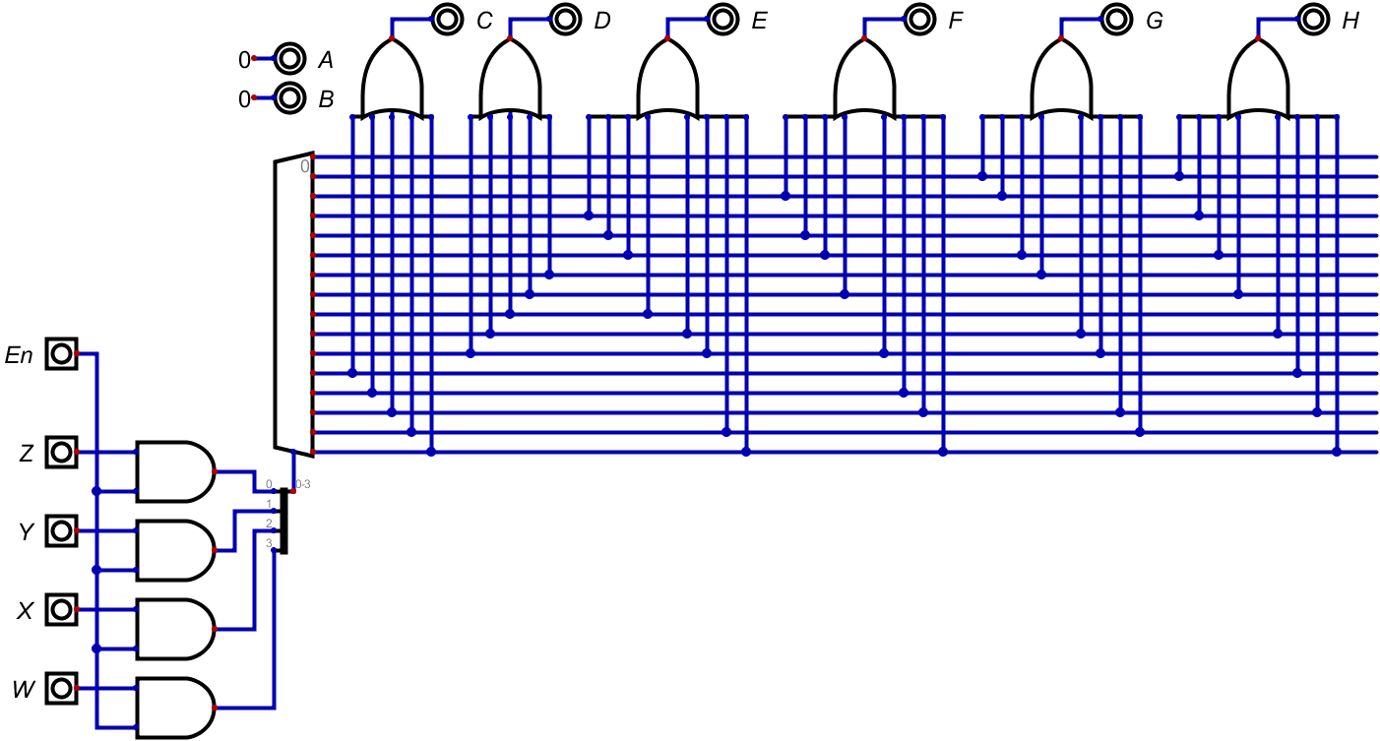
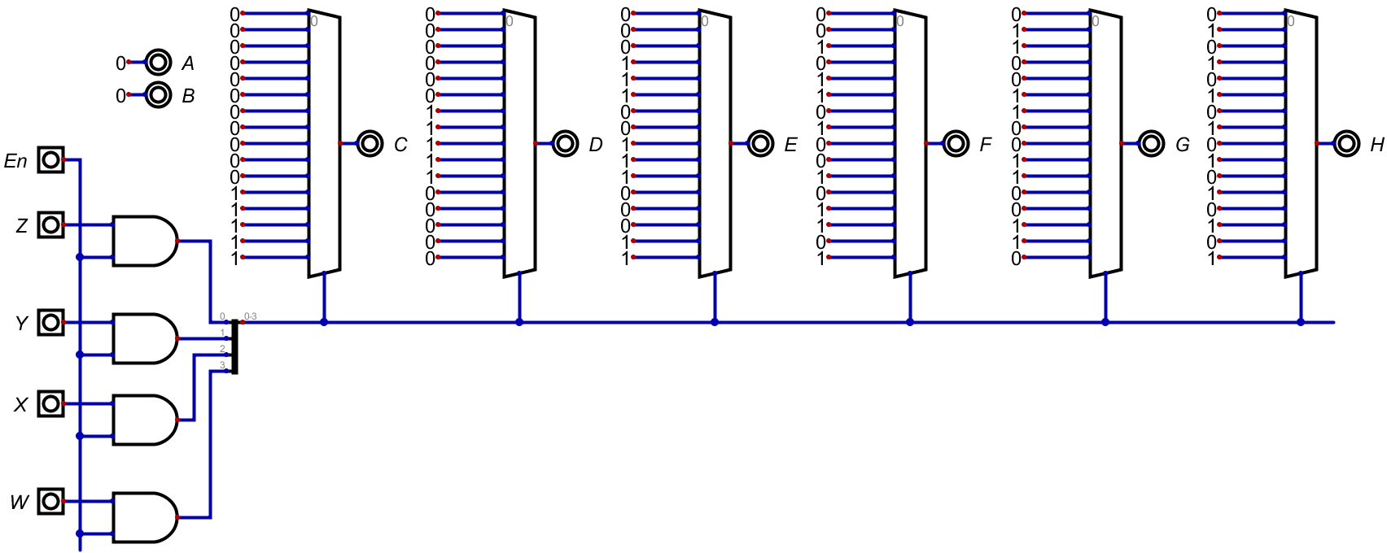
Multiplication table of Three design
Combinational (C M3T)
Decoder (D M3T)
Multiplexer (M M3T)

Slide 30
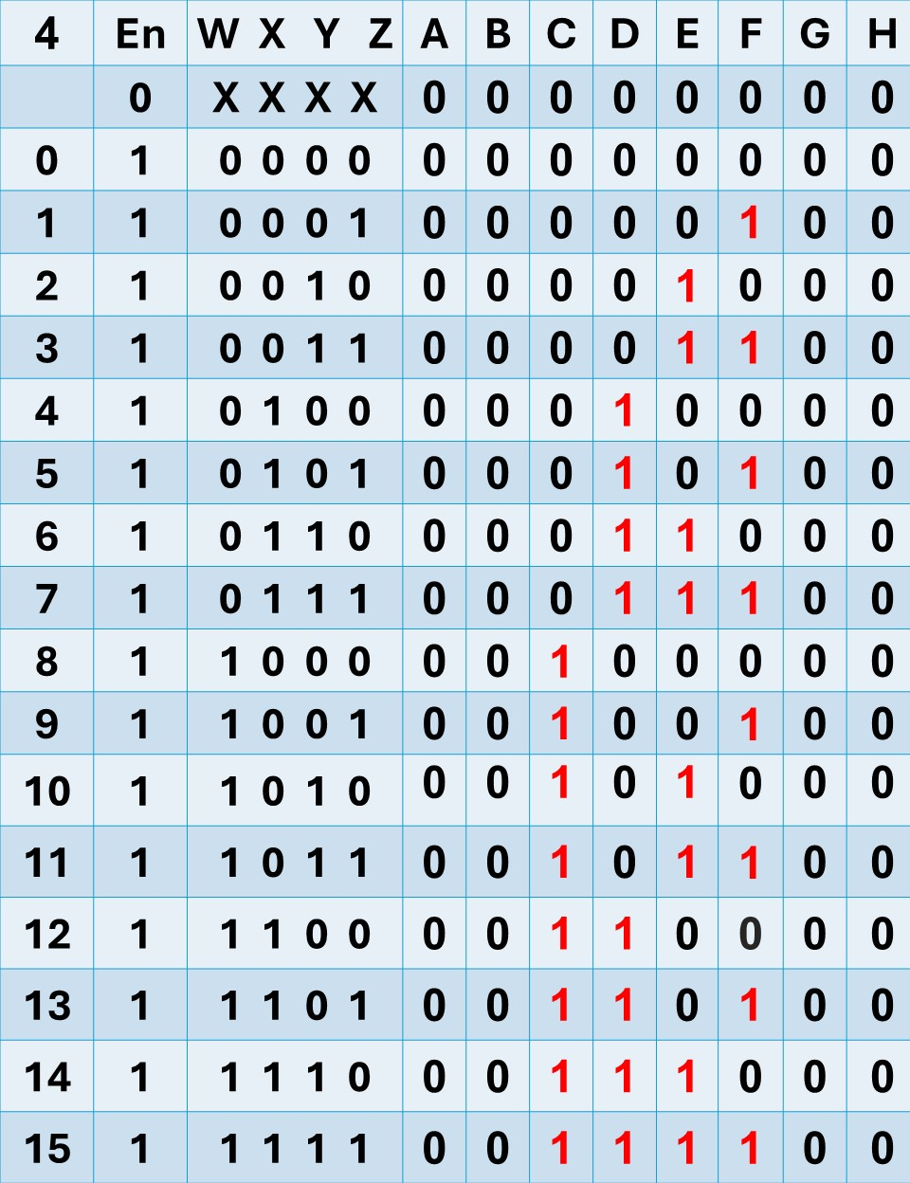
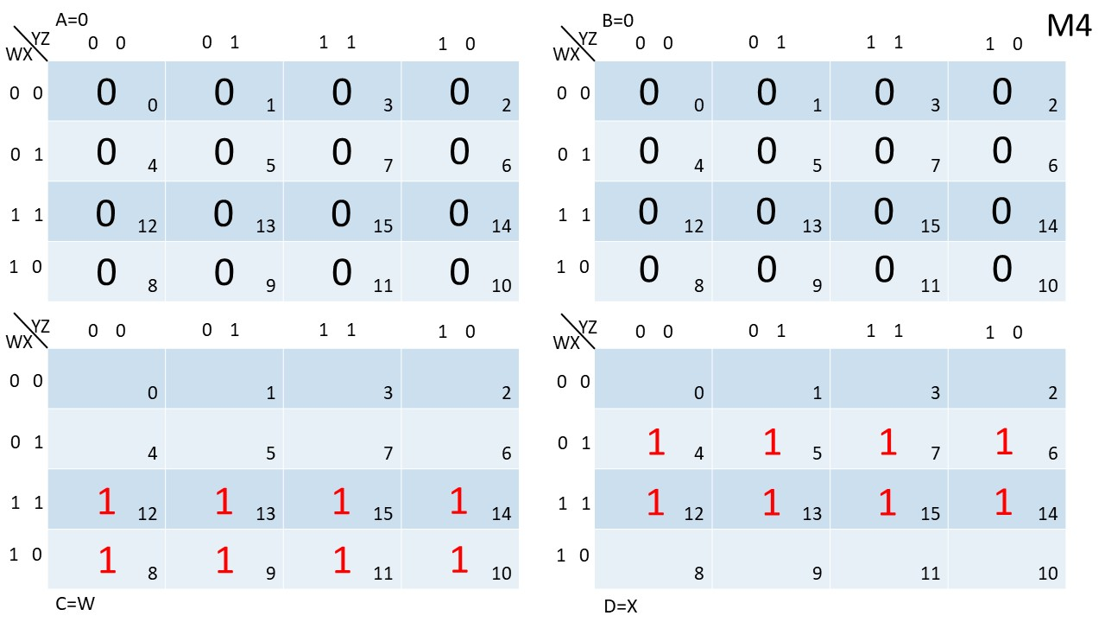
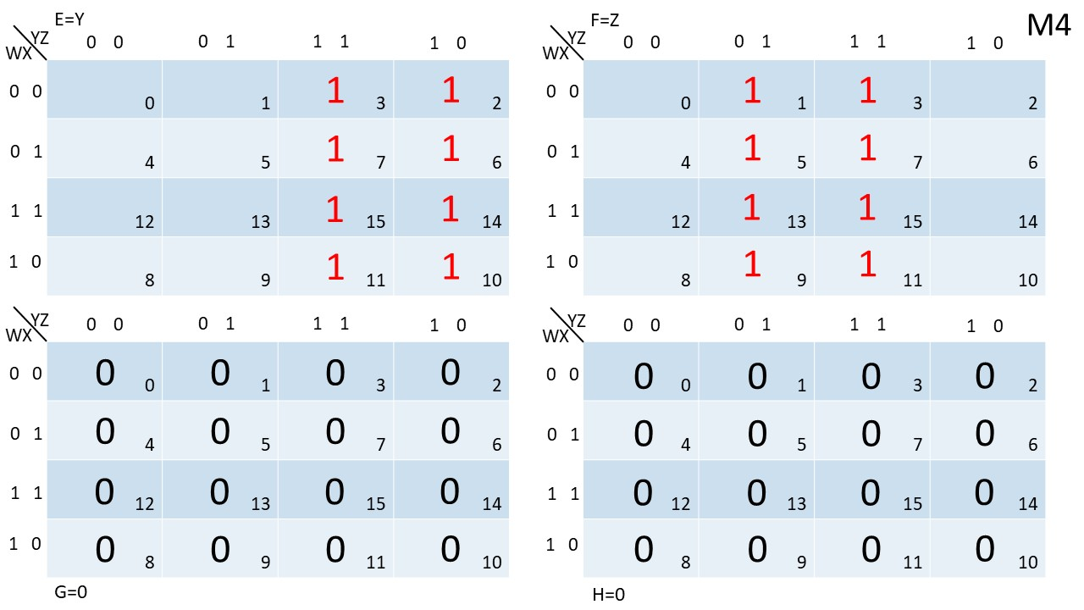
Multiplication table of Four

Slide 31
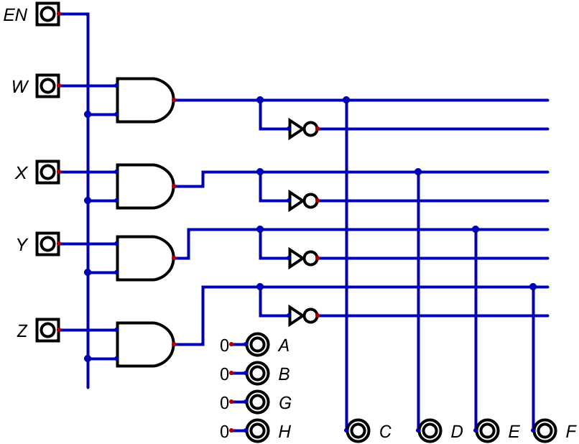
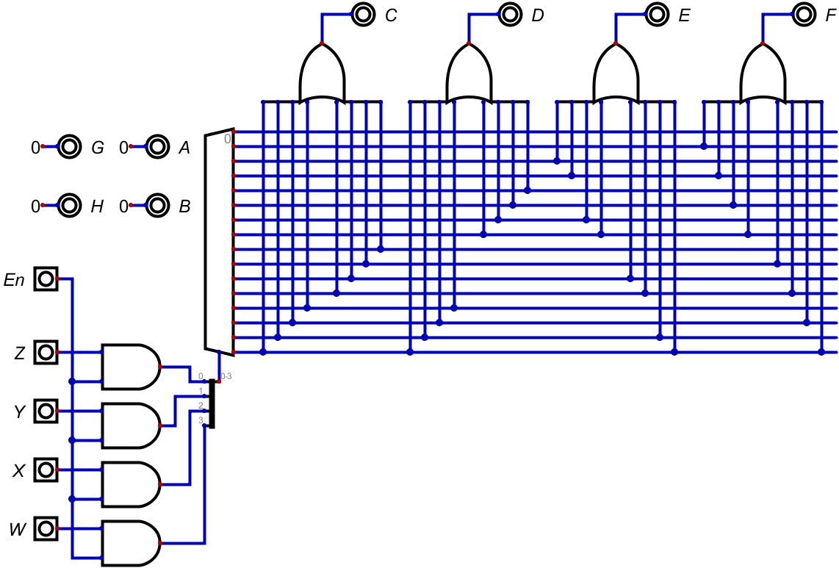
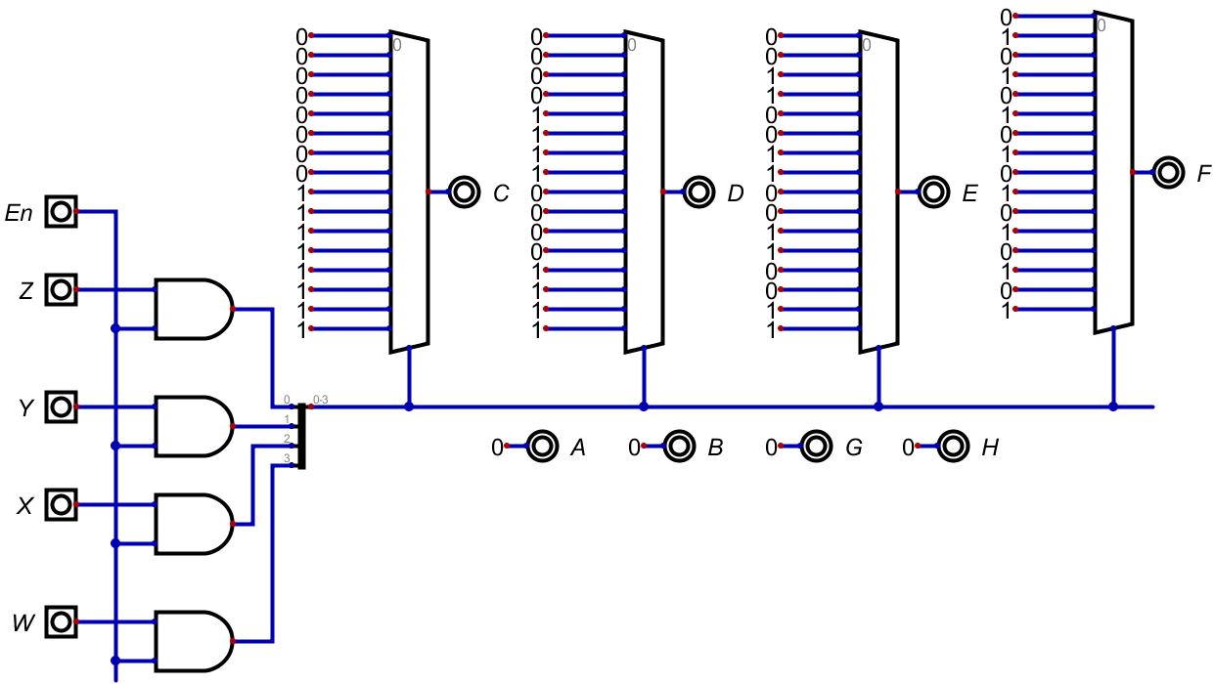
Multiplication table of Four design
Combinational (C M4T)
Decoder (D M4T)
Multiplexer (M M4T)

Slide 32
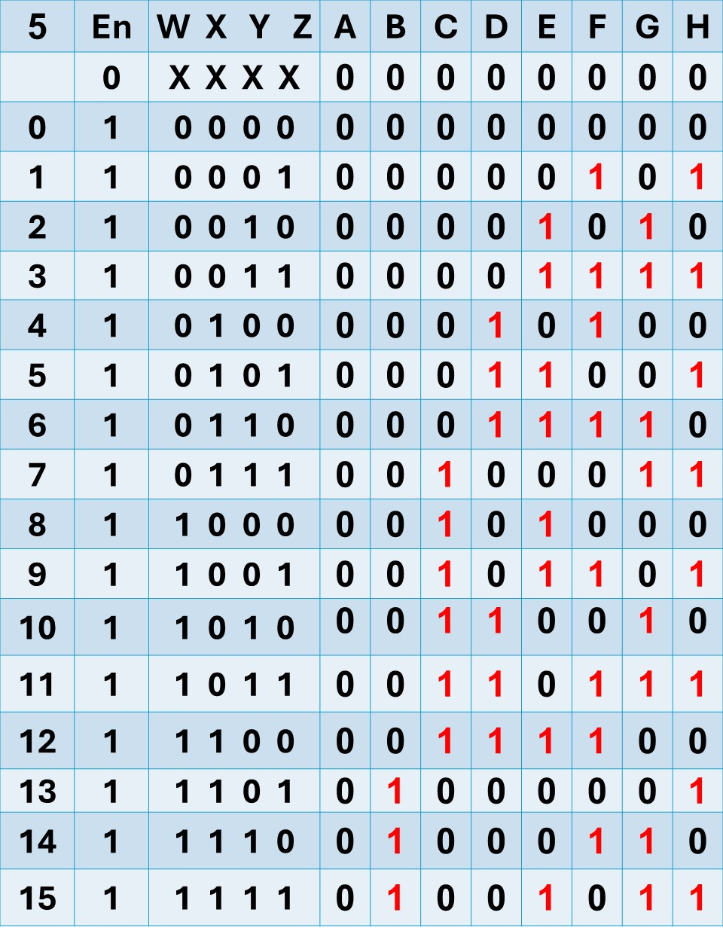


Multiplication table of Five

Slide 33



Multiplication table of Five design
Combinational (C M5T)
Decoder (D M5T)
Multiplexer (M M5T)

Slide 34



Multiplication table of Six

Slide 35



Multiplication table of Six design
Combinational (C M6T)
Decoder (D M6T)
Multiplexer (M M6T)

Slide 36



Multiplication table of Seven

Slide 37



Multiplication table of Seven design
Combinational (C M7T)
Decoder (D M7T)
Multiplexer (M M7T)

Slide 38



Multiplication table of Eight

Slide 39



Multiplication table of Eight design
Combinational (C M8T)
Decoder (D M8T)
Multiplexer (M M8T)

Slide 40



Multiplication table of Nine

Slide 41



Multiplication table of Nine design
Combinational (C M9T)
Decoder (D M9T)
Multiplexer (M M9T)

Slide 42



Multiplication table of Ten

Slide 43



Multiplication table of Ten design
Combinational (C M10T)
Decoder (D M10T)
Multiplexer (M M10T)

Slide 44



Multiplication table of Eleven

Slide 45



Multiplication table of Eleven design
Combinational (C M11T)
Decoder (D M11T)
Multiplexer (M M11T)

Slide 46



Multiplication table of Twelve

Slide 47



Multiplication table of Twelve design
Combinational (C M12T)
Decoder (D M12T)
Multiplexer (M M12T)

Slide 48



Multiplication table of Thirteen

Slide 49



Multiplication table of Thirteen design
Combinational (C M13T)
Multiplexer (M M13T)
Decoder (D M13T)

Slide 50



Multiplication table of Fourteen

Slide 51



Multiplication table of Fourteen design
Combinational (C M14T)
Decoder (D M14T)
Multiplexer (M M14T)

Slide 52



Multiplication table of Fifteen

Slide 53



Multiplication table of Fifteen design
Combinational (C M15T)
Decoder (D M15T)
Multiplexer (M M15T)

